Slide 1

Lecture Notes on Color Perception
. 1. %. {. . {. . . . . . . .
This work is licensed under the Creative Commons Attribution-Noncommercial 2.5 License. To view a copy of this license, visit http://creativecommons.org/licenses/by-nc/2.5/ or send a letter to Creative Commons, 543 Howard Street, 5th Floor, San Francisco, California, 94105, USA.

Slide 2
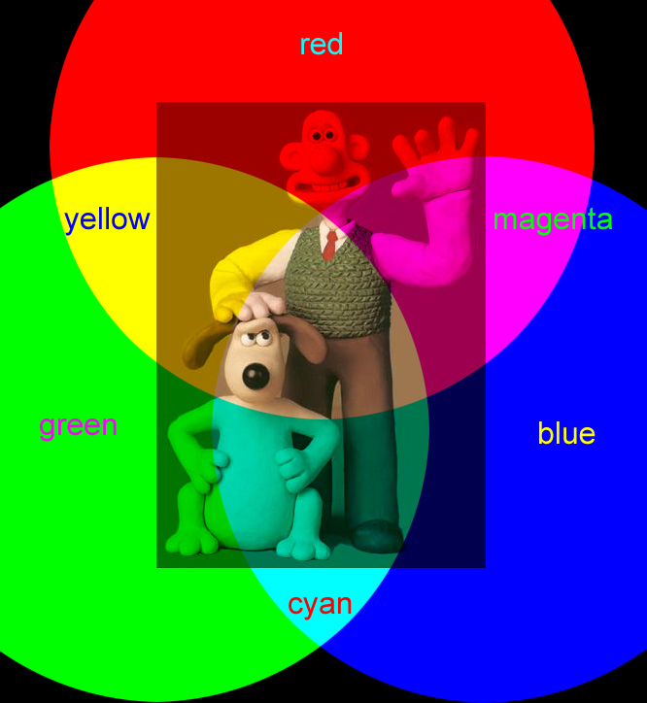
Color Images
Are constructed from three intensity maps.
Each intensity map is projected through a color filter (e.g., red, green, or blue, or cyan, magenta, or yellow) to create a single color image.
The intensity maps are overlaid to create a color image.
Each pixel in a color image is a three element vector.

Slide 3
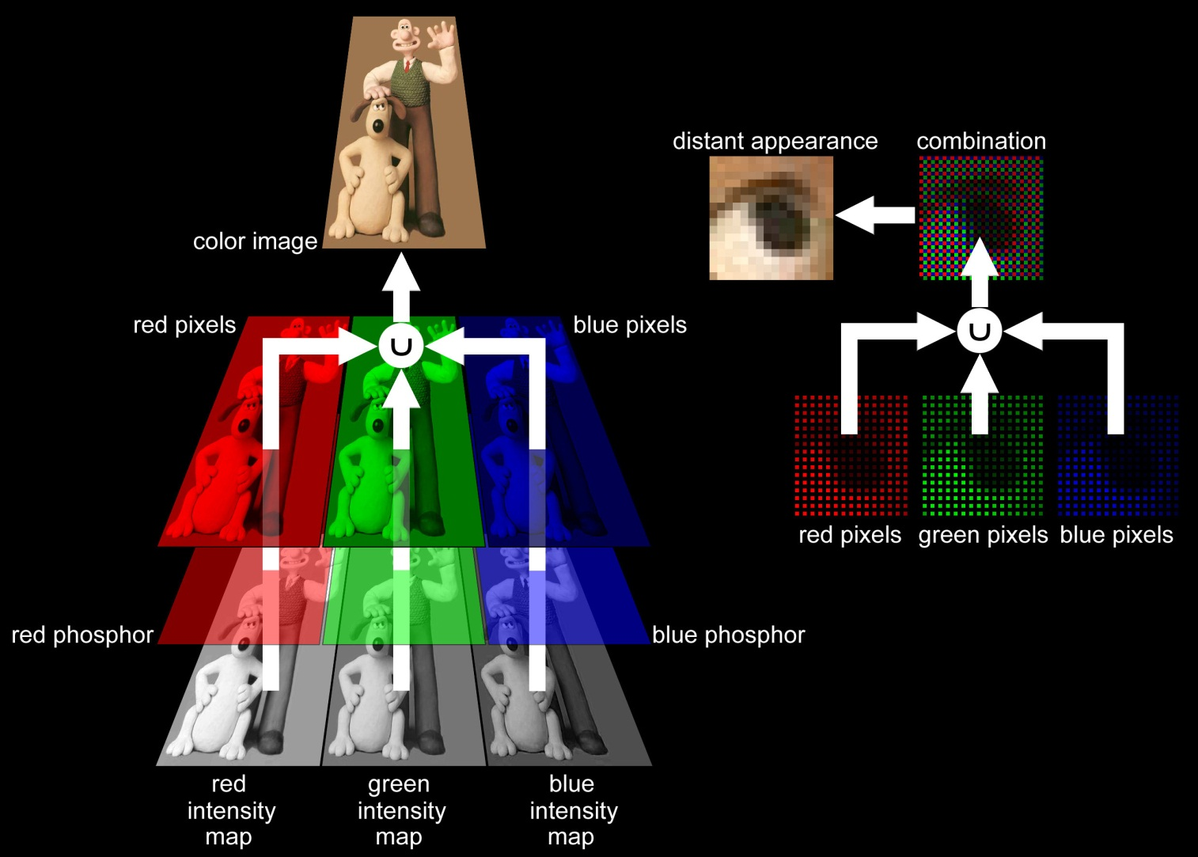
Color Images on a CRT or LCD Display
Projected image primary colors: red, green, and blue.
Intensity images are projected through dot-array color filters which are slightly offset from one another.

Slide 4
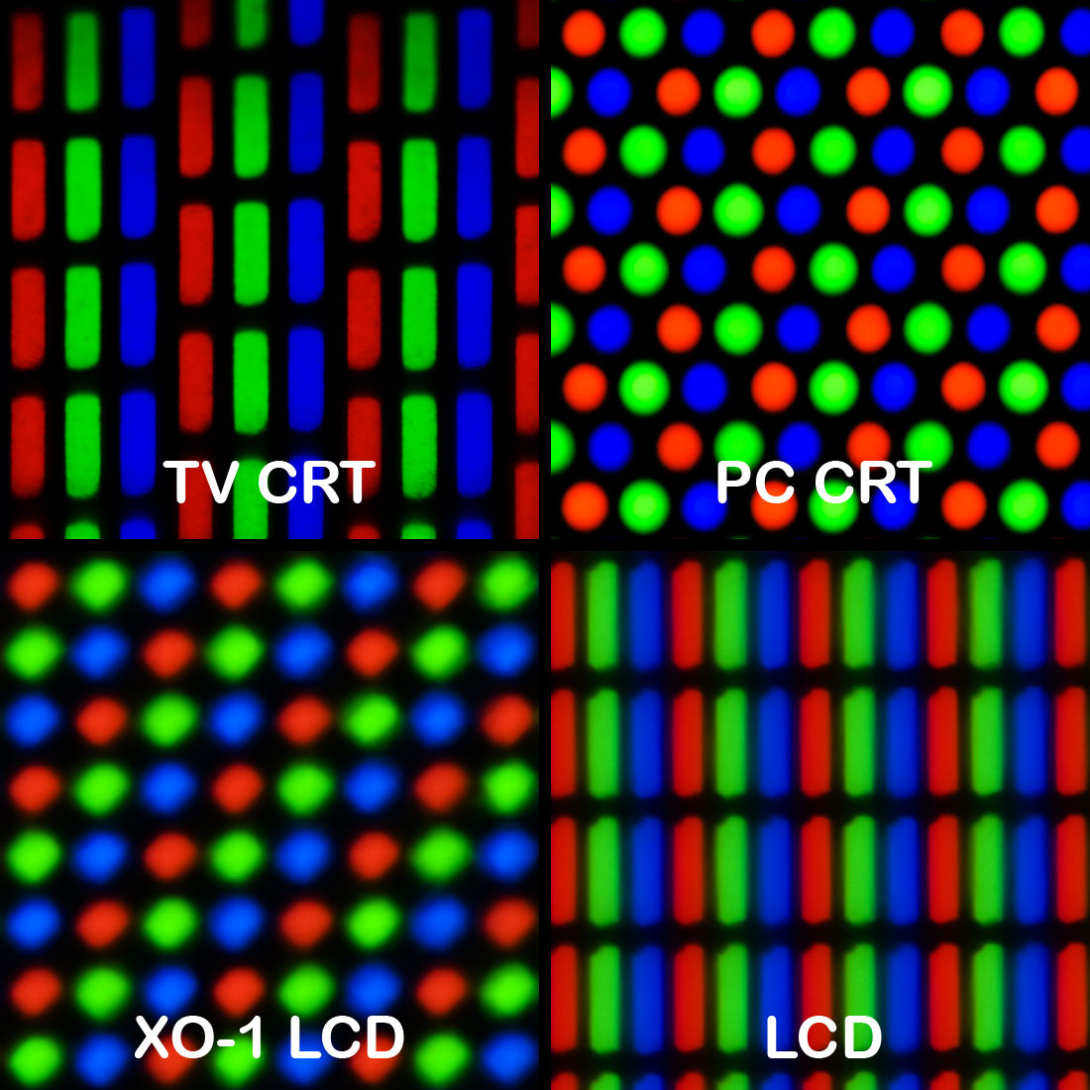
Color Images on a CRT or LCD Display
Photographs of various displays, showing various pixel geometries. Clockwise from top left, a standard definition CRT television, a CRT computer monitor, a laptop LCD, and the OLPC XO-1 LCD display. [Peter Halasz (user:Pengo), Wikipedia, http://en.wikipedia.org/wiki/Pixel_geometry]

Slide 5
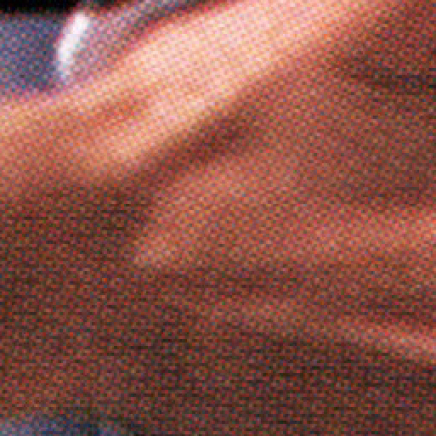
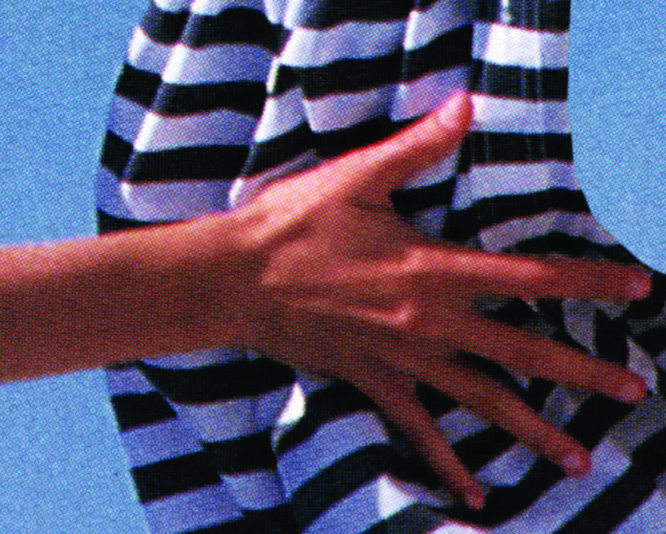
Color Images In Print
Images are separated into four color bands, each of which is printed as a grid regularly spaced dots. A dot’s diameter varies in proportion to the intensity of the color.

Slide 6
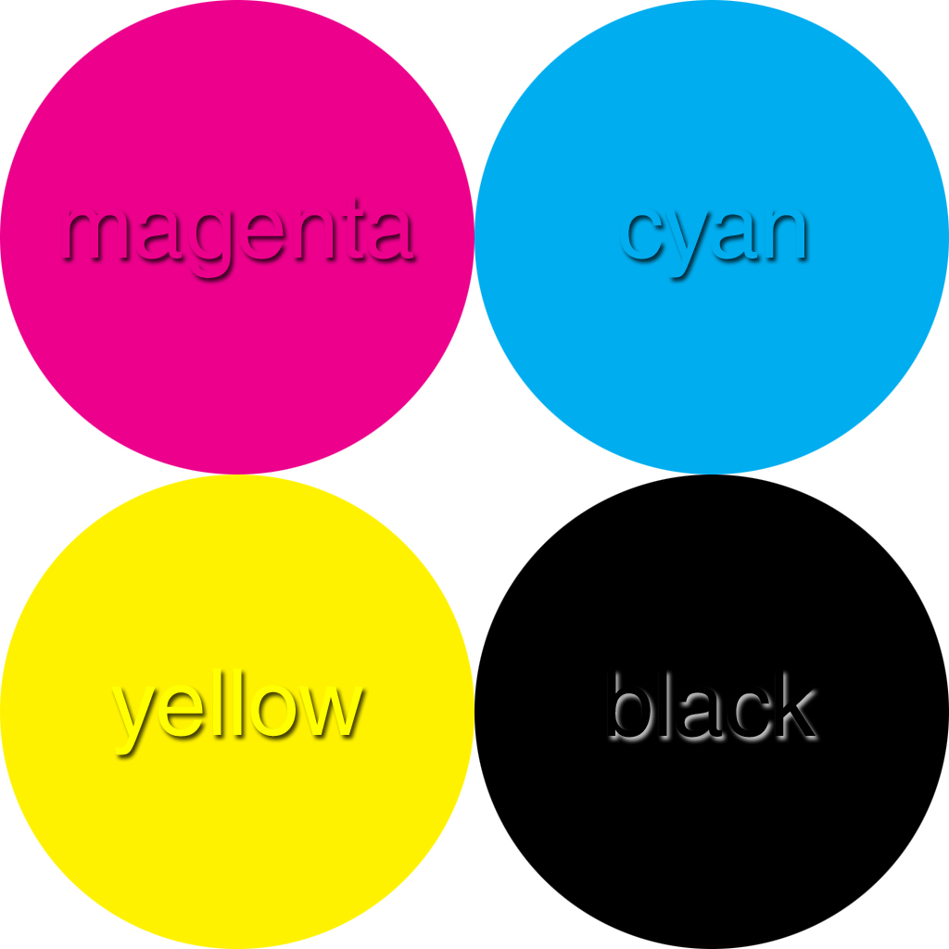
Color Images in Print
The four colors are magenta, cyan, yellow, and black

Slide 7
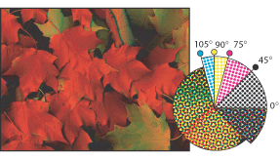
Standard Halftone Screen Angles
The dot grids are created with a screen that overlays the intensity images.
Cyan: 105°
Yellow: 90°
Magenta: 75°
Black: 45°
The screens are oriented at different angles.
The resulting patterns are called “rosettes”.

Slide 8
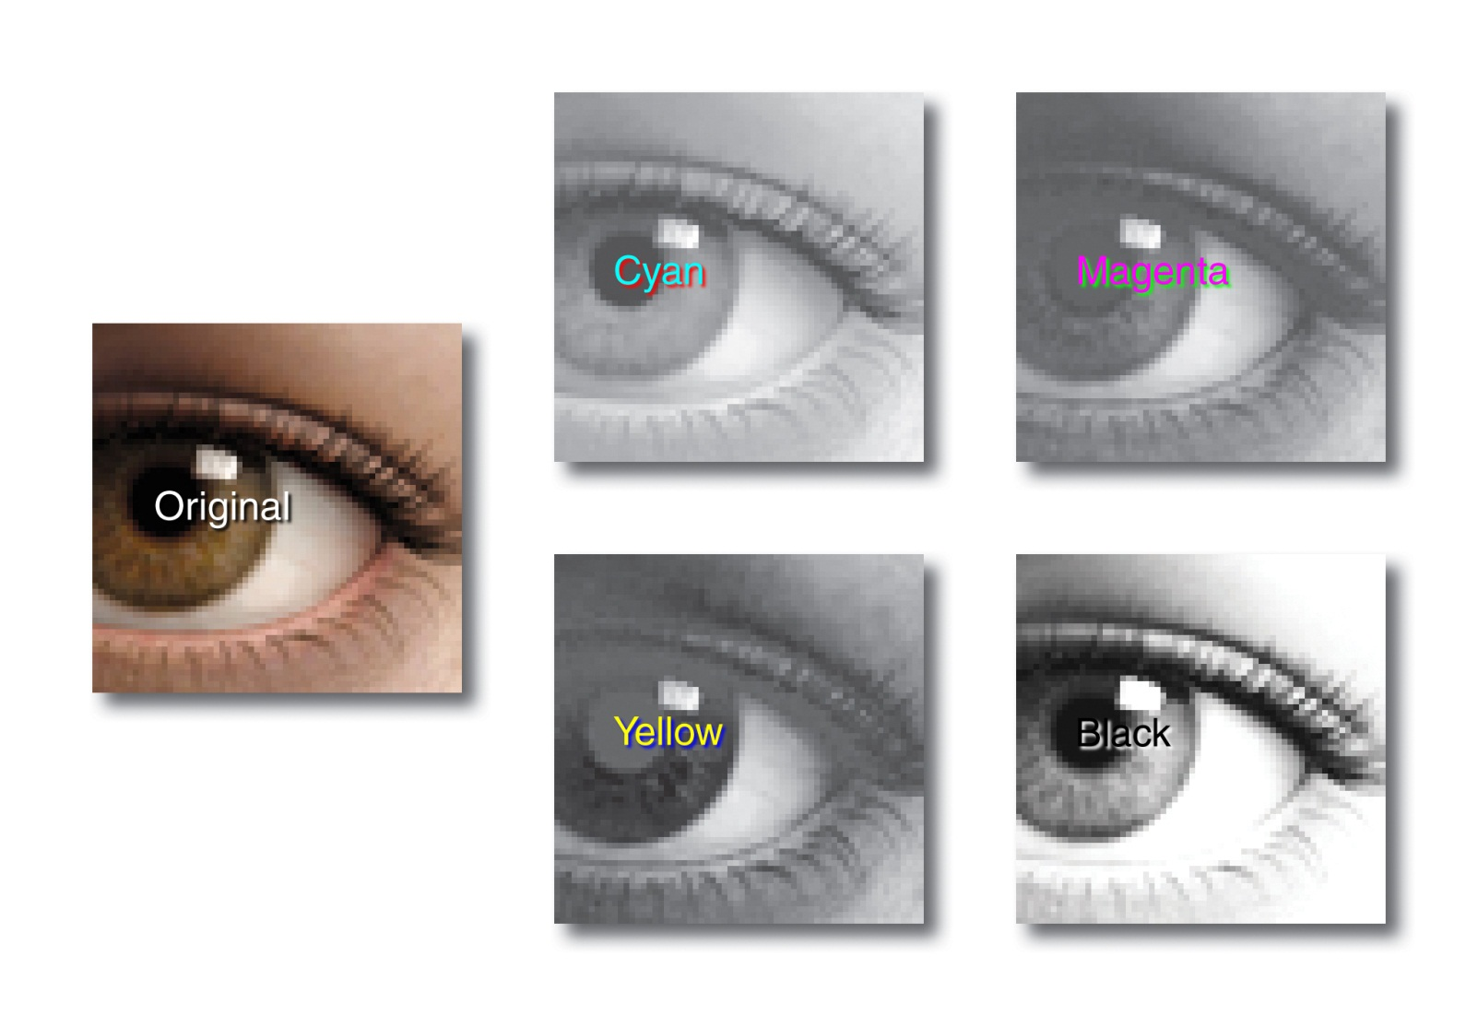
Color Separation / Halftoning
The original is separated into an intensity image for each of the four color bands.

Slide 9
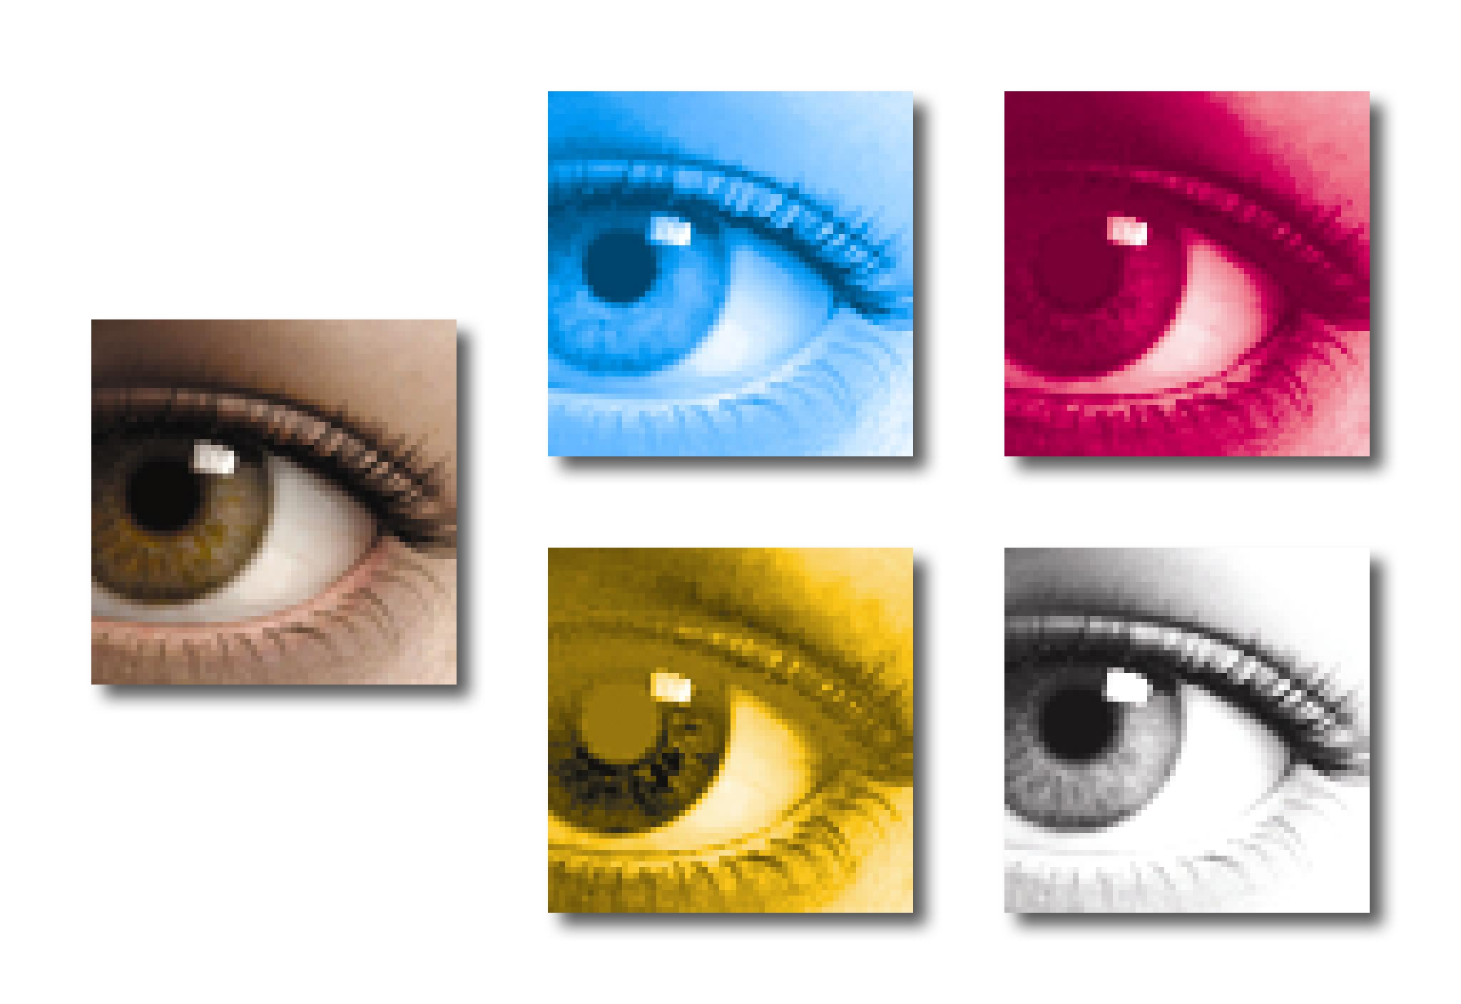
Color Separation / Halftoning

Slide 10
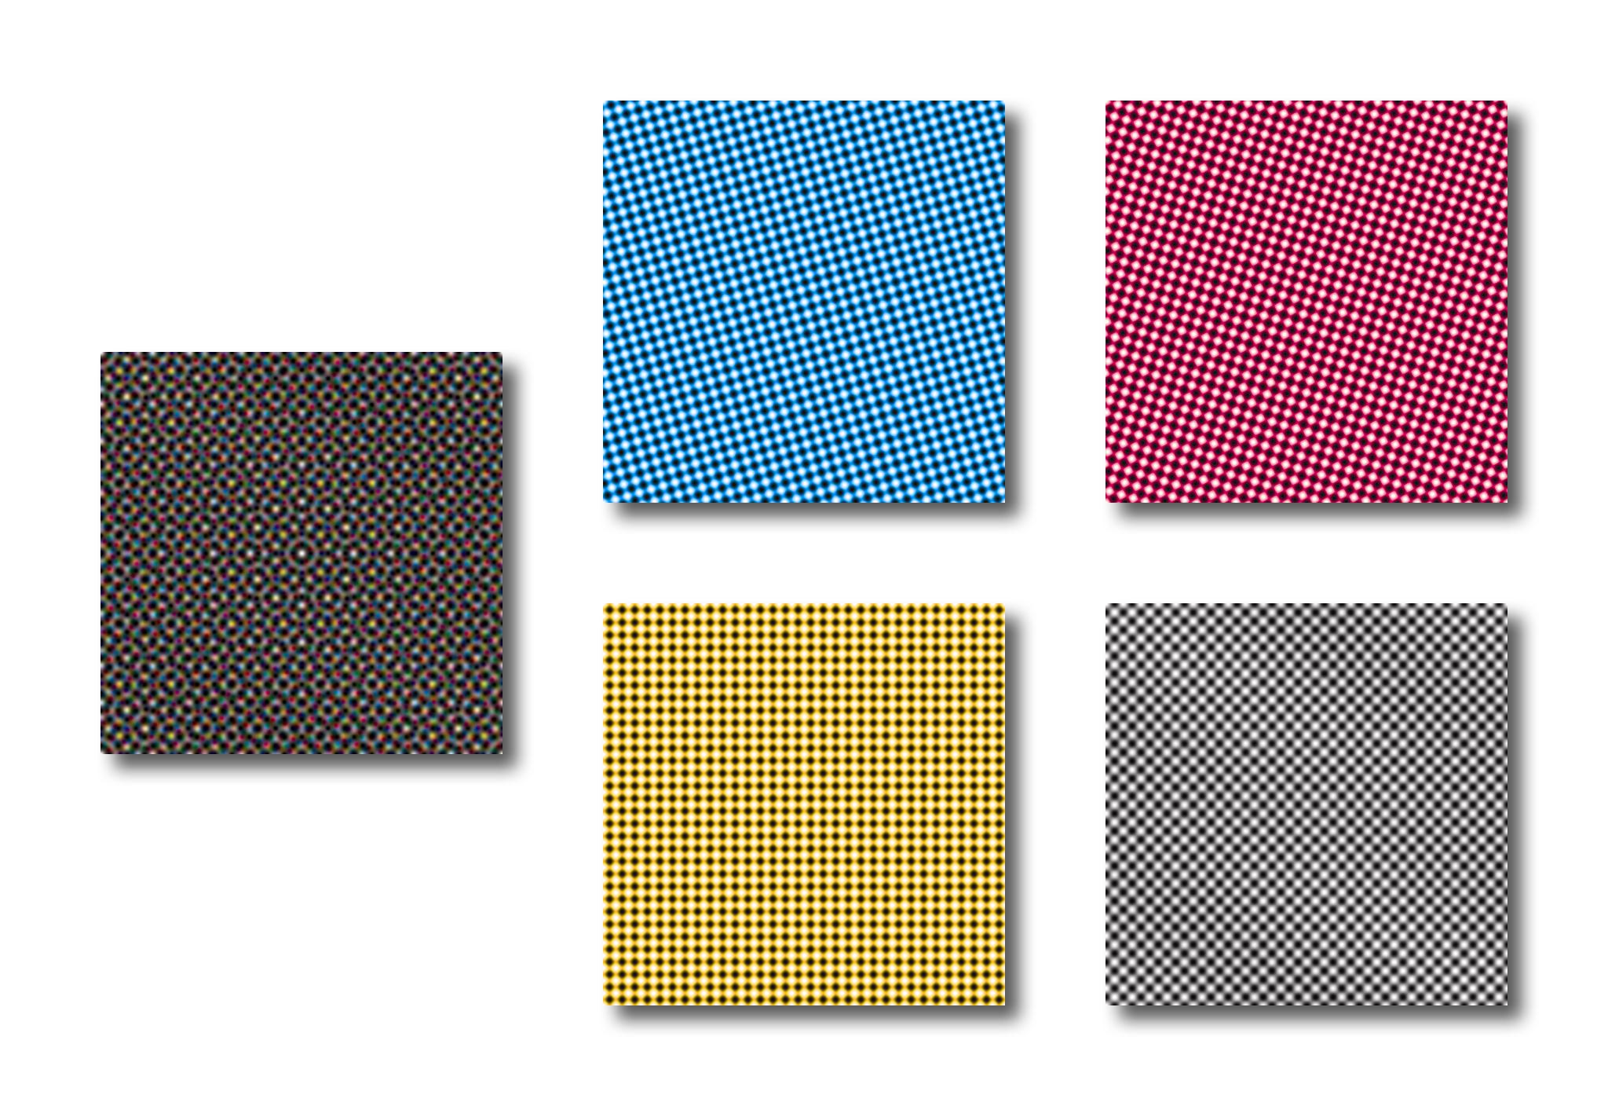
Color Separation / Halftoning
Each intensity image is multiplied by a corresponding “screen”,
Cyan
Magenta
Yellow
Black
Each screened image is printed in its own color on the same page.

Slide 11
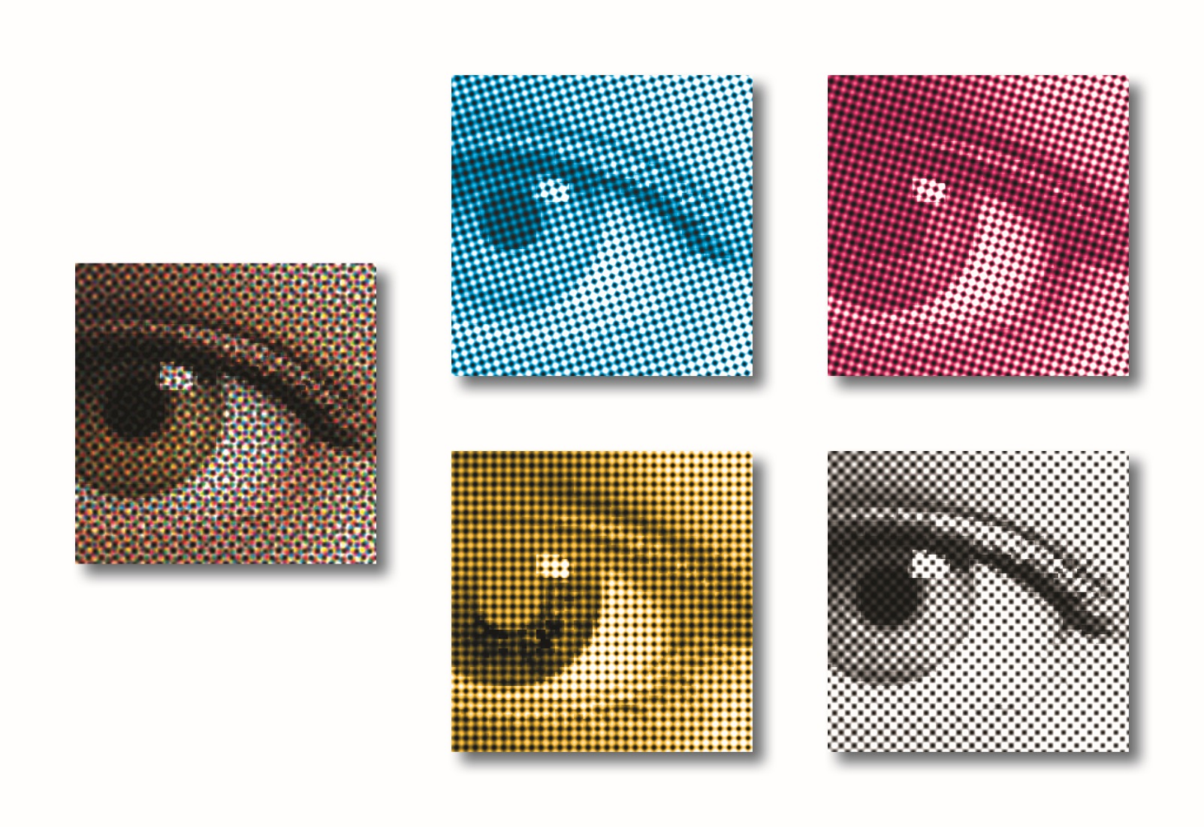
Color Separation / Halftoning
Results:
Cyan
Magenta
Yellow
Black

Slide 12
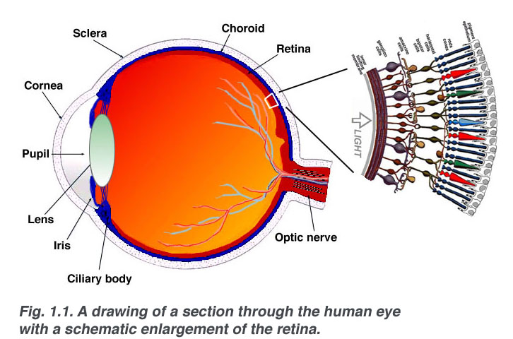
The Eye
Diagram from http://webvision.med.utah.edu/

Slide 13
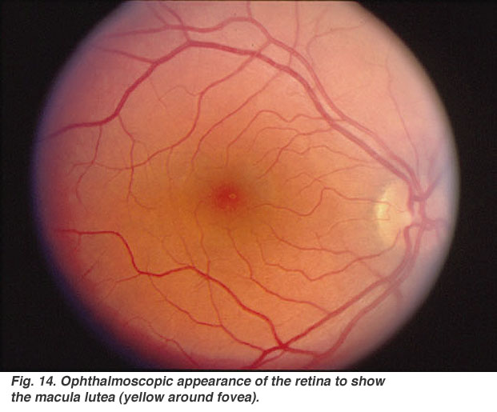
The Retina
¹Klaus Rohrschneider, “Determination of the Location of the Fovea on the Fundus,” Invest. Ophthalmol. Vis. Sci. September 2004 vol. 45 no. 9 3257-3258
Fovea
When measured in 104 healthy people, the horizontal angle from the center of the fovea to the meridian through the center of the optic nerve head varied from 13.0° to 17.9°; the vertical angle from the foveal center to the parallel through the optic nerve head was in the range -3.65 to +0.65°.¹
Macula
Optic nerve
Diagram from http://webvision.med.utah.edu/

Slide 14
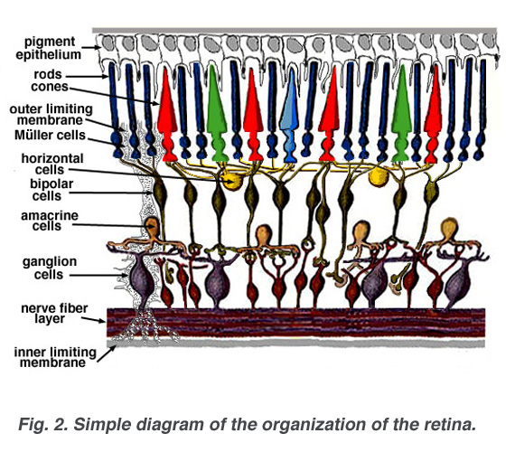
The Retina
Light
Diagram from http://webvision.med.utah.edu/

Slide 15
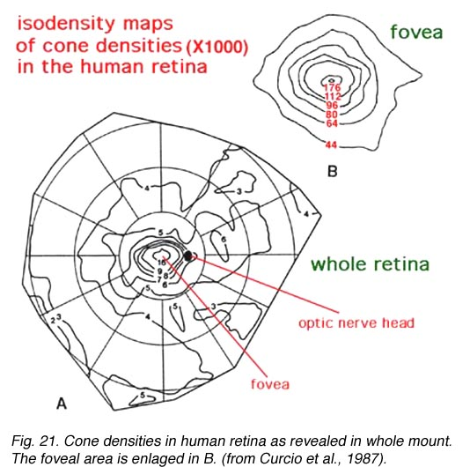
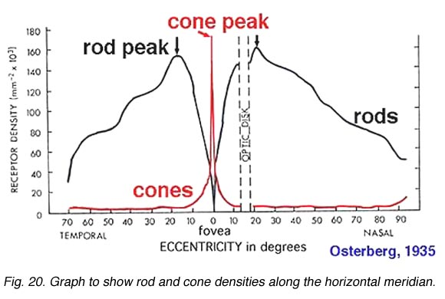
Photoreceptor Densities
Diagrams from http://webvision.med.utah.edu/

Slide 16
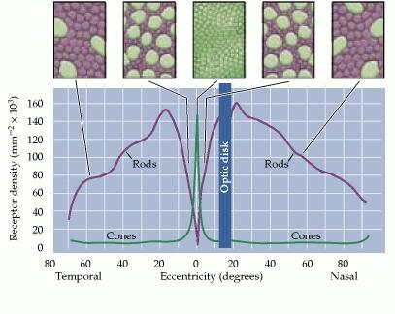
Photoreceptor Densities
The density of cone photoreceptors decreases from the high-resolution fovea to the periphery of the eye. A human eye’s field of view is about 155° of that, the fovea comprises the central 2°. To see the world in detail requires active scanning by the eyes. A person does not see much more than he or she does see in most situations. The slides that follow mimic a multiresolution scan of a painting by a single eye. (The digital image processing in this case was done with a log-polar transform.)
Figure: Anatomical Distribution of Rods and Cones
from Neuroscience. 2nd edition.
Purves D, Augustine GJ, Fitzpatrick D, et al., editors.
Sunderland (MA): Sinauer Associates; 2001.
http://www.ncbi.nlm.nih.gov/books/NBK10848/

Slide 17
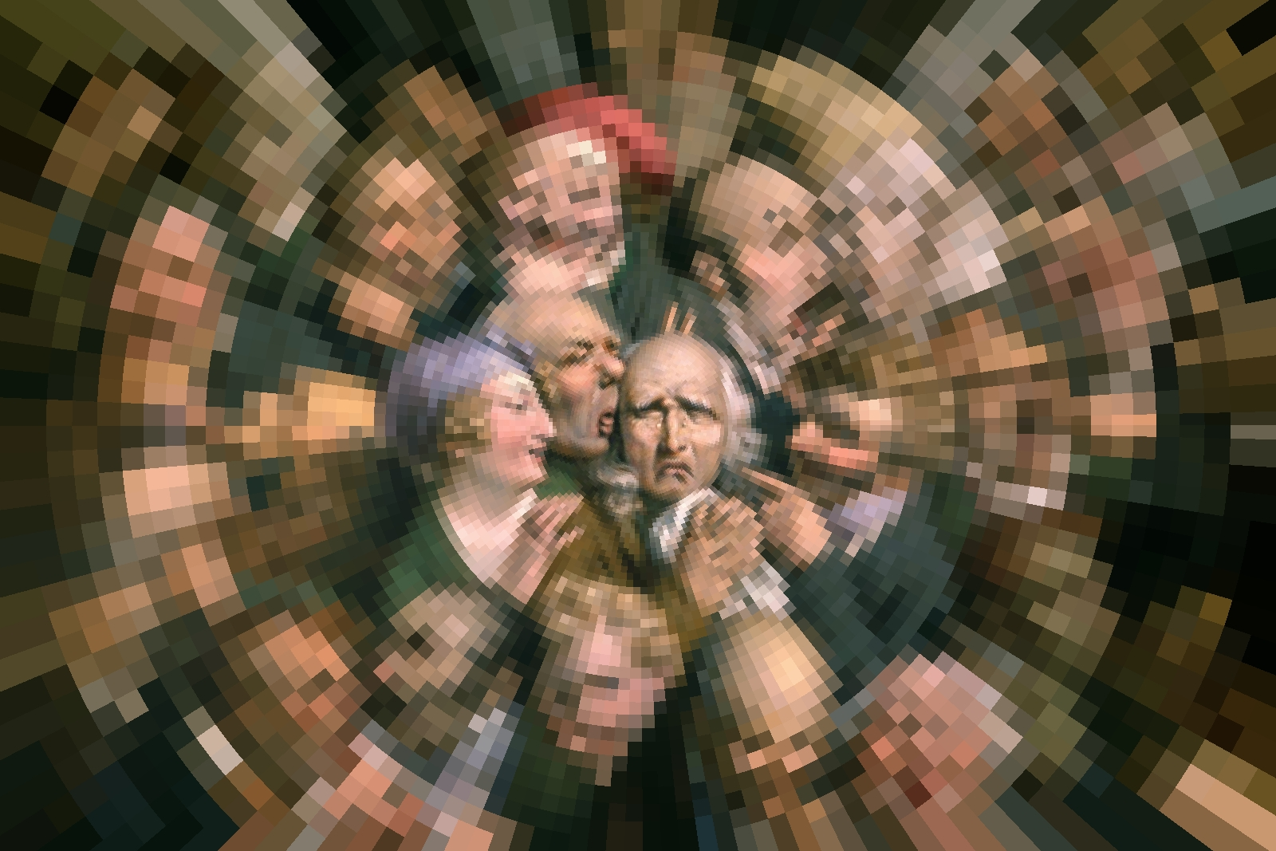
Retinal Space-Variant Sensing
Louis Boilly (1761-1845) Thirty-Six Faces of Expression. Log-polar transform applied.

Slide 18
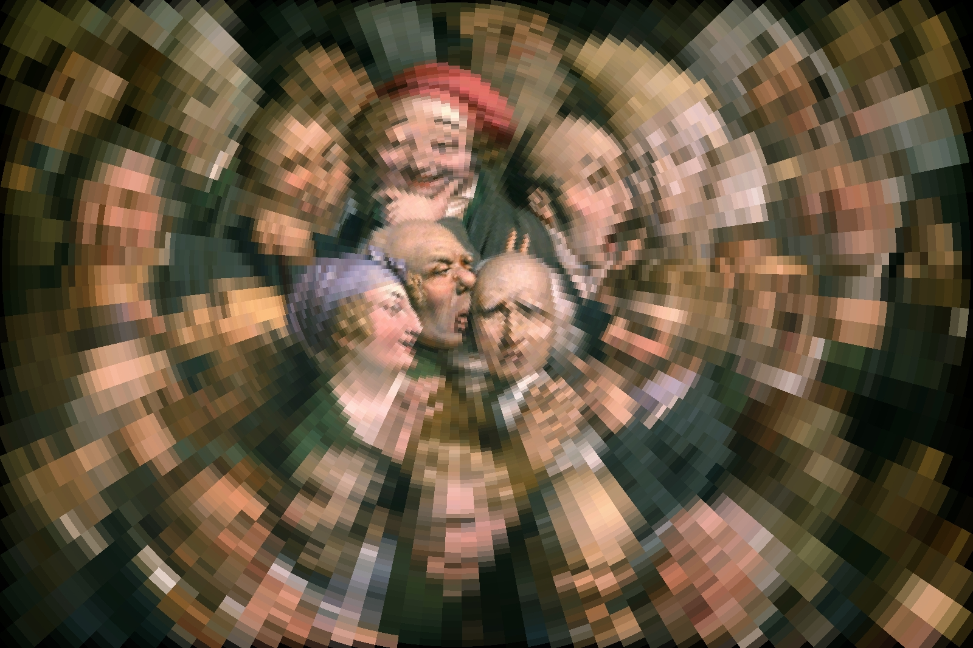
Retinal Space-Variant Sensing
Louis Boilly (1761-1845) Thirty-Six Faces of Expression. Log-polar transform applied.

Slide 19
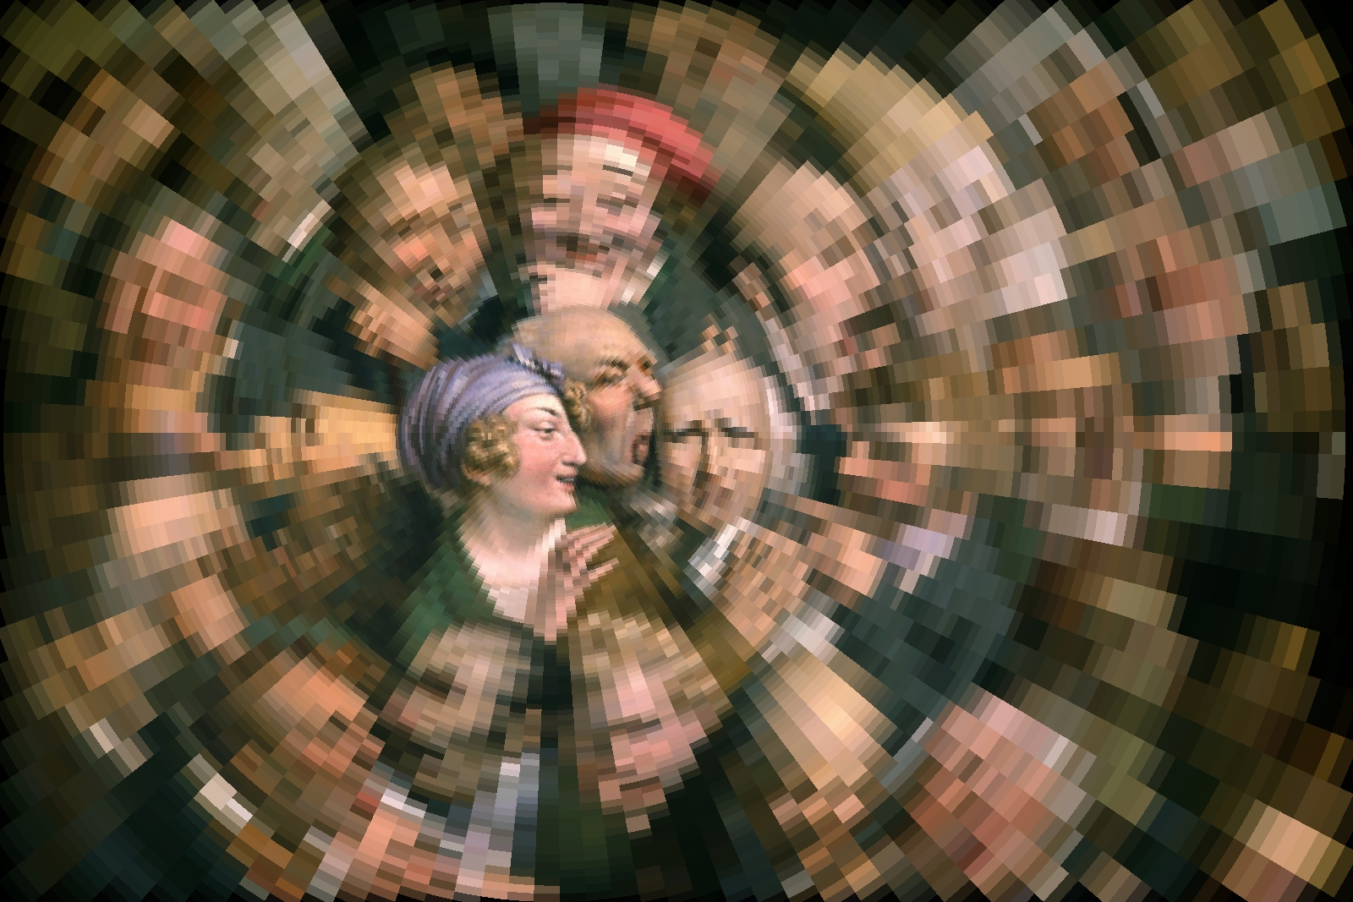
Retinal Space-Variant Sensing
Louis Boilly (1761-1845) Thirty-Six Faces of Expression. Log-polar transform applied.

Slide 20
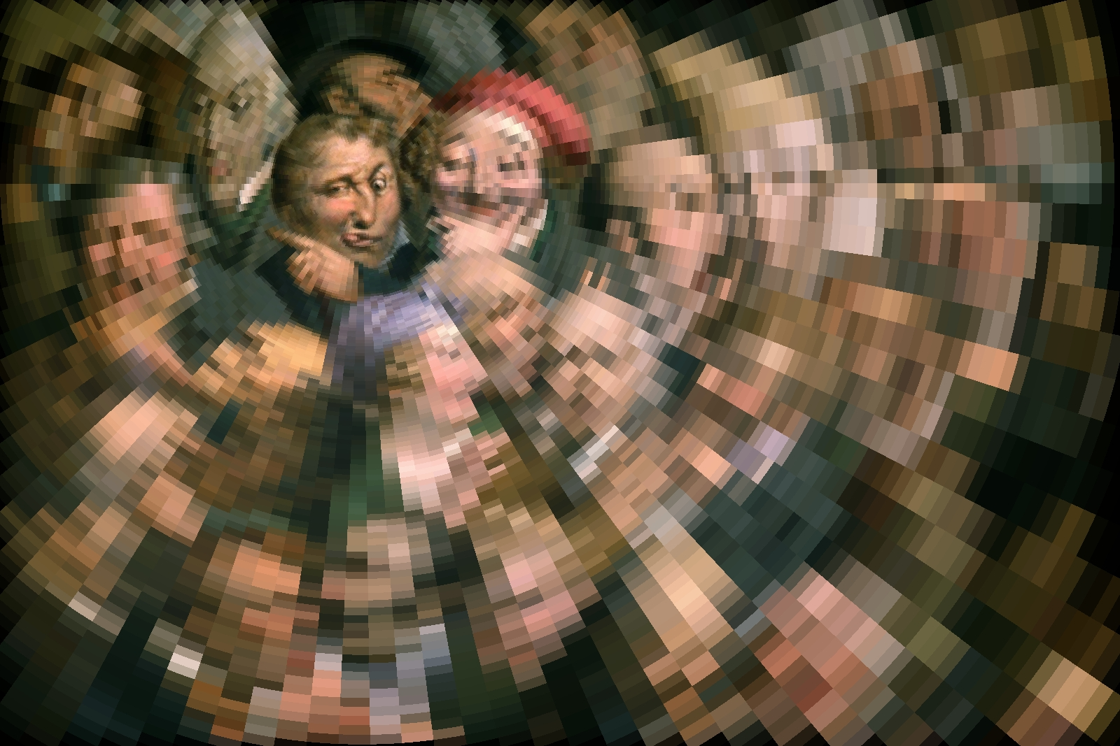
Retinal Space-Variant Sensing
Louis Boilly (1761-1845) Thirty-Six Faces of Expression. Log-polar transform applied.

Slide 21
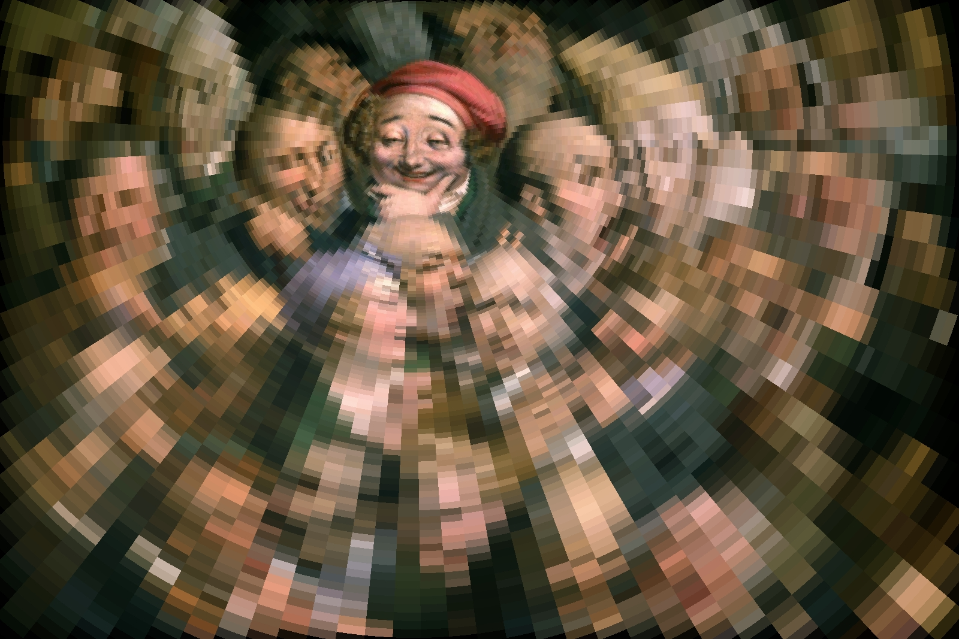
Retinal Space-Variant Sensing
Louis Boilly (1761-1845) Thirty-Six Faces of Expression. Log-polar transform applied.

Slide 22
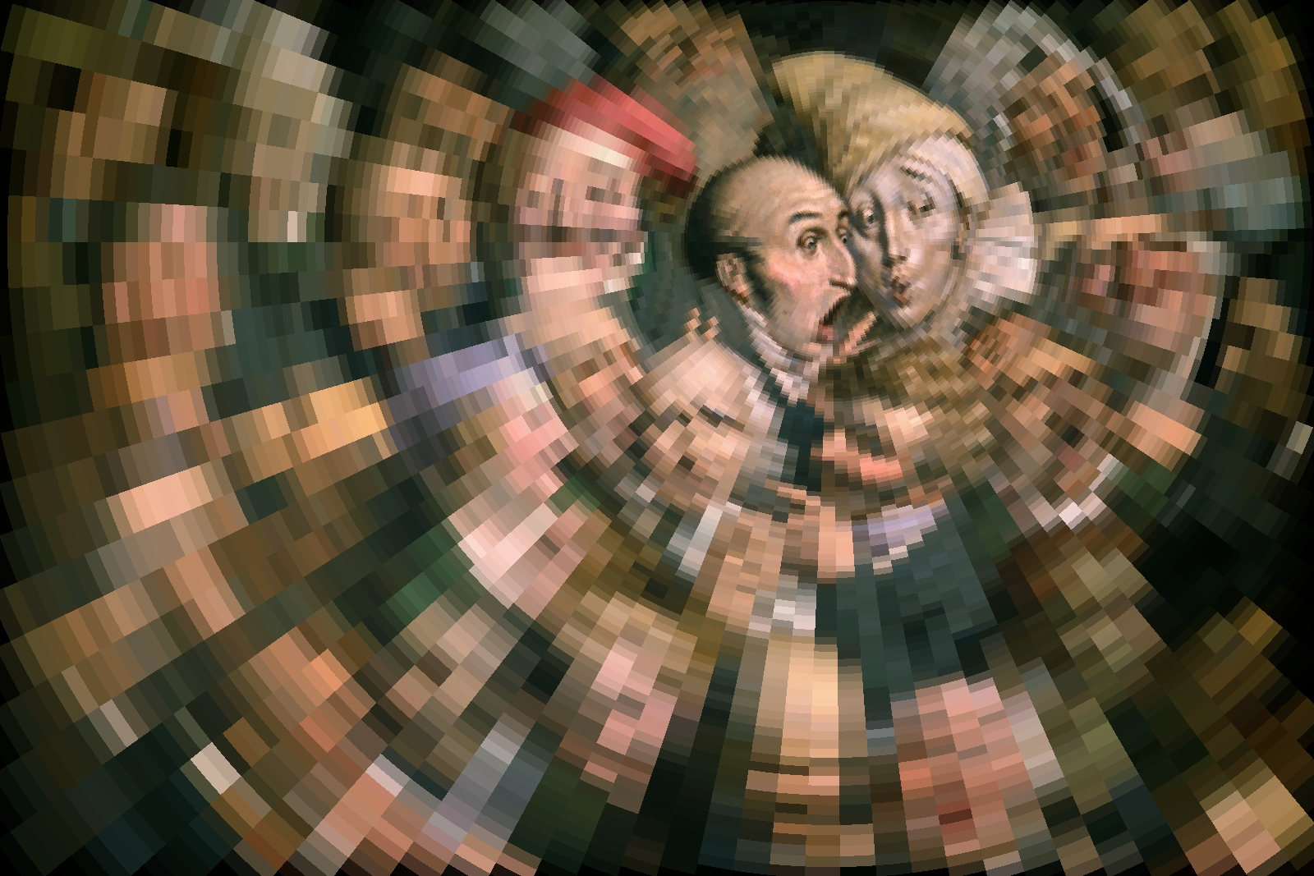
Retinal Space-Variant Sensing
Louis Boilly (1761-1845) Thirty-Six Faces of Expression. Log-polar transform applied.

Slide 23
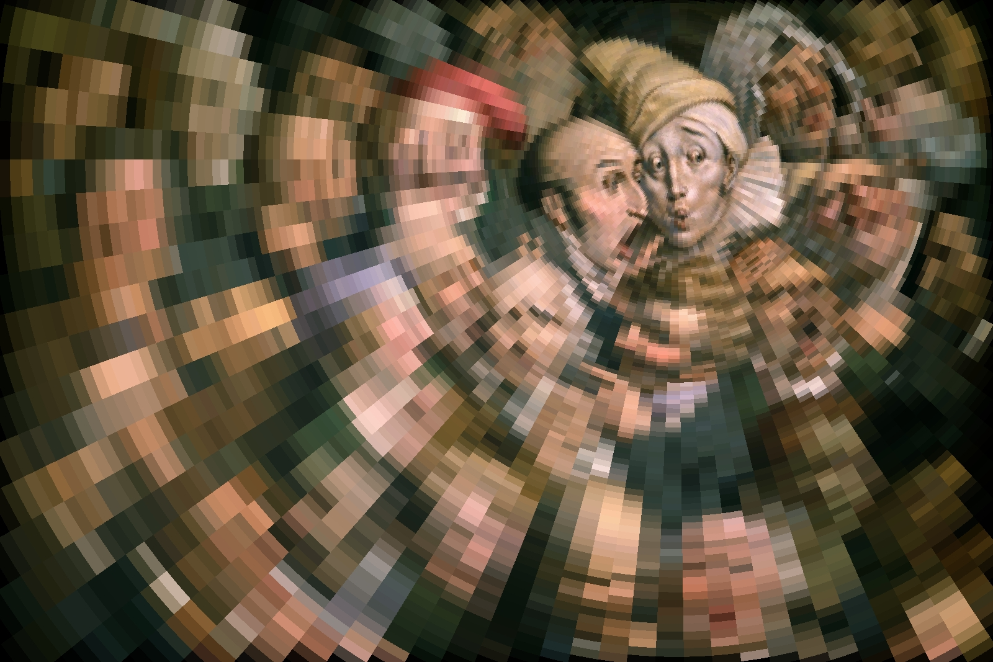
Retinal Space-Variant Sensing
Louis Boilly (1761-1845) Thirty-Six Faces of Expression. Log-polar transform applied.

Slide 24
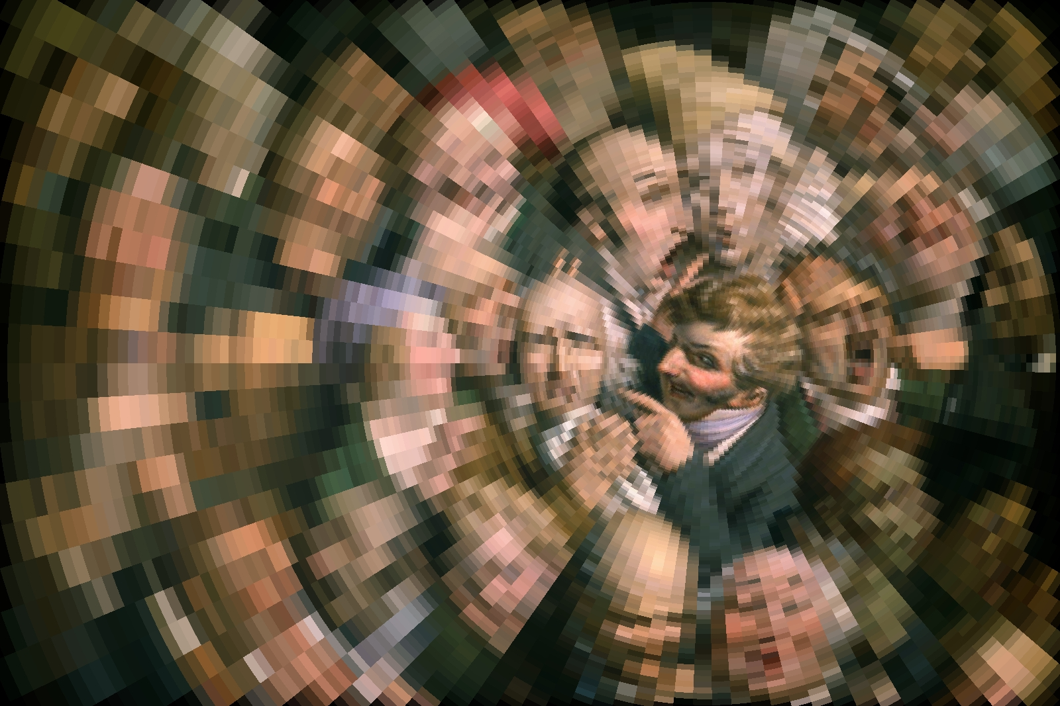
Retinal Space-Variant Sensing
Louis Boilly (1761-1845) Thirty-Six Faces of Expression. Log-polar transform applied.

Slide 25
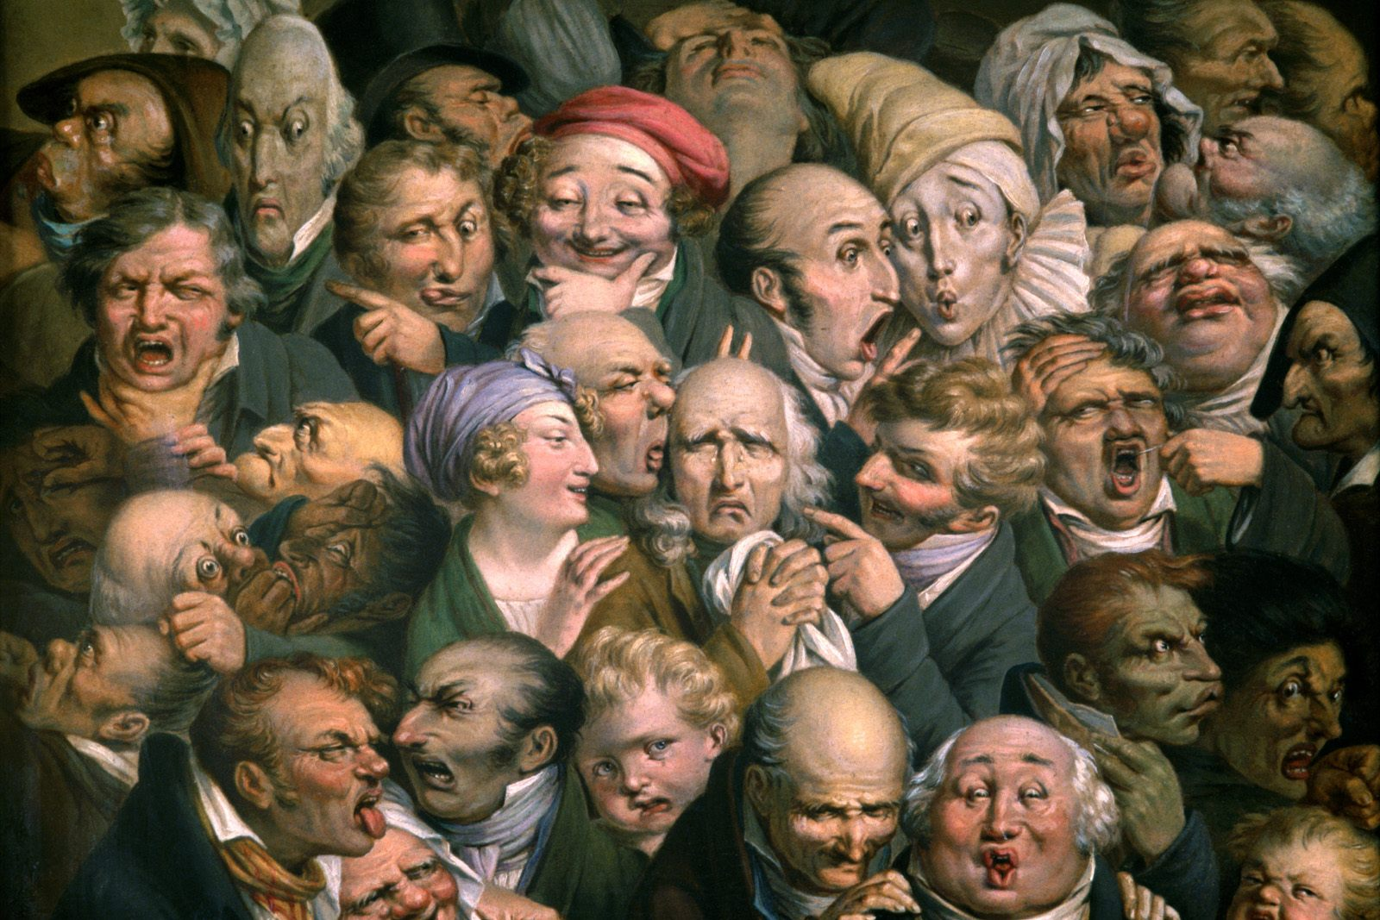
Retinal Space-Variant Sensing
Louis Boilly (1761-1845) Thirty-Six Faces of Expression.

Slide 26
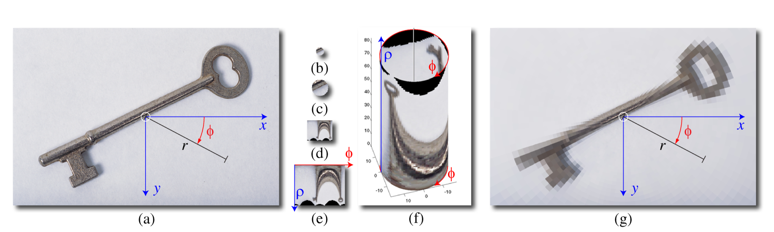
The Log Polar Transform
(a) Original image with a left-handed coordinate system originating at (x₀, y₀), the center of the image. (b) Fovea (actual size for this particular transform). (c) Fovea (enlarged 2×). (d) Log-polar transform (LPT), unwrapped (actual size). The origin is in the upper left-hand corner. The ρ-axis is down and the φ-axis is to the right. (e) LPT, unwrapped, enlarged 2×. (f) LPT on cylinder. The origin is at the bottom. The ρ-axis is up and the φ-axis is clockwise to the left. (g) LPT image backward-mapped onto the original image.

Slide 27
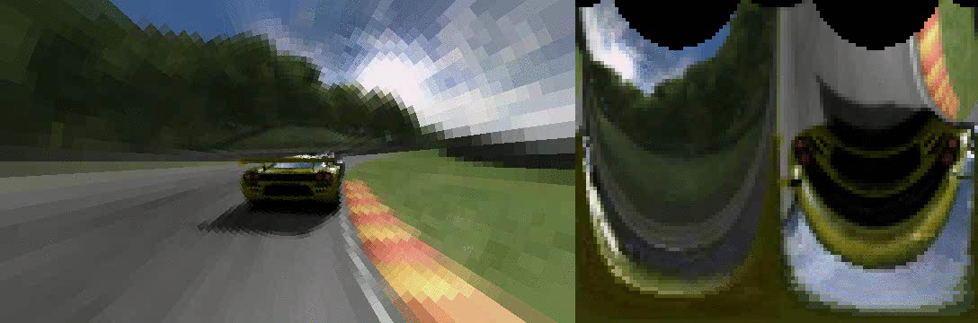
Space Variant Visual Motion

Slide 28
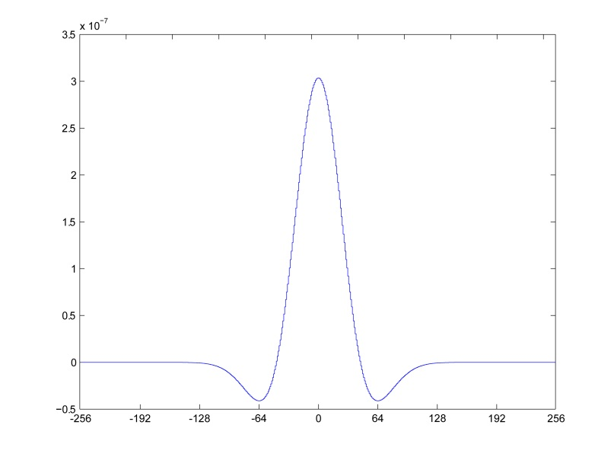
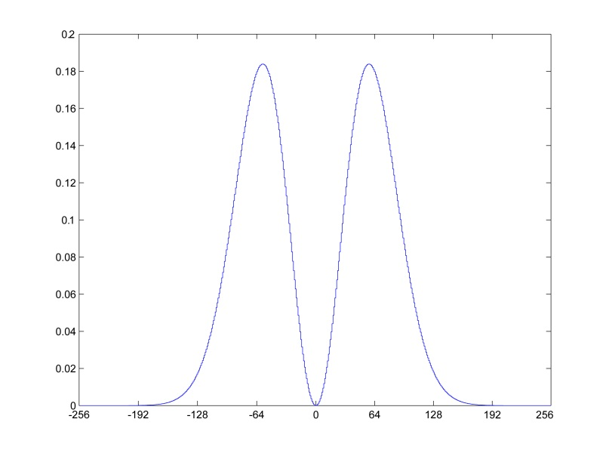


Retina: Center-Surround Edge Detector
spatial domain
σ = 32
frequency domain
σ = 2
The interconnection of the photoreceptors by the other cells in the retina cause its output to be an edge map, similar to the action of a Laplacian of Gaussian filter on a digital image.
Laplacian of Gaussian (LoG) Filter

Slide 29
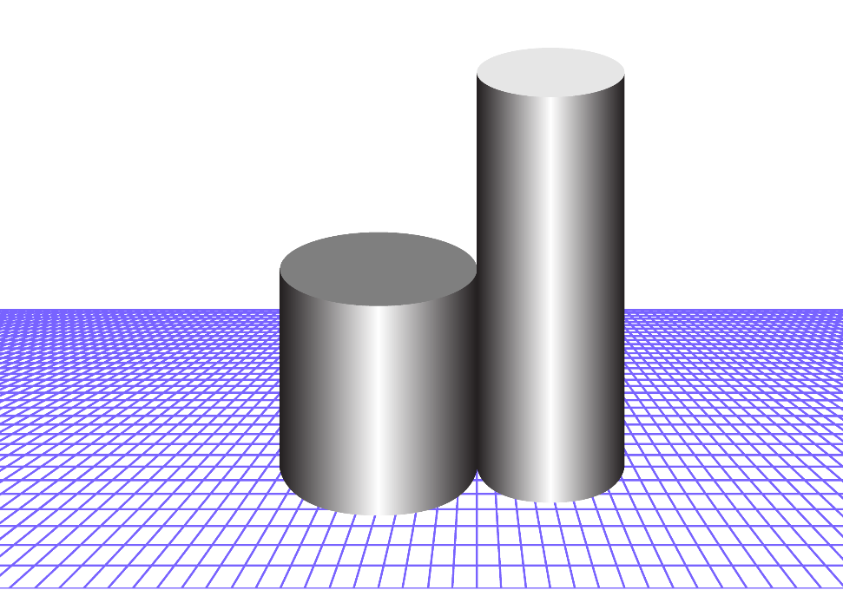
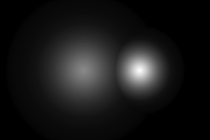
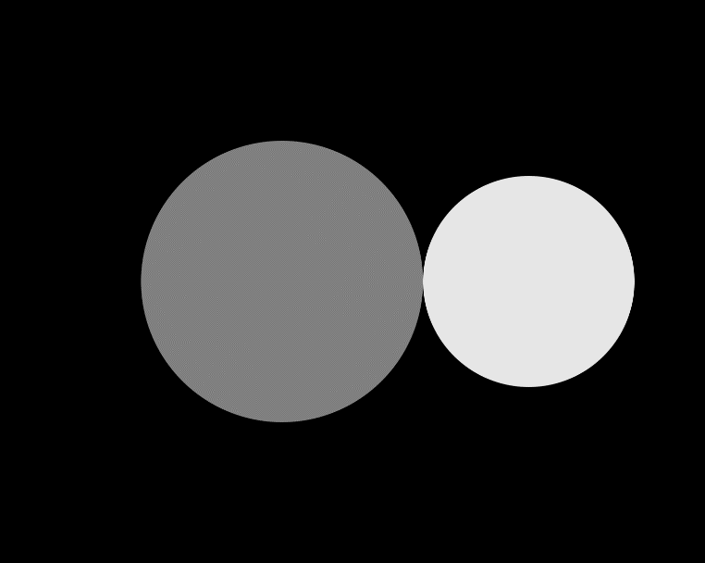
Center-Surround Brightness Perception
255
0
image
intensity profile
False bright edge next to dark edge.

Slide 30
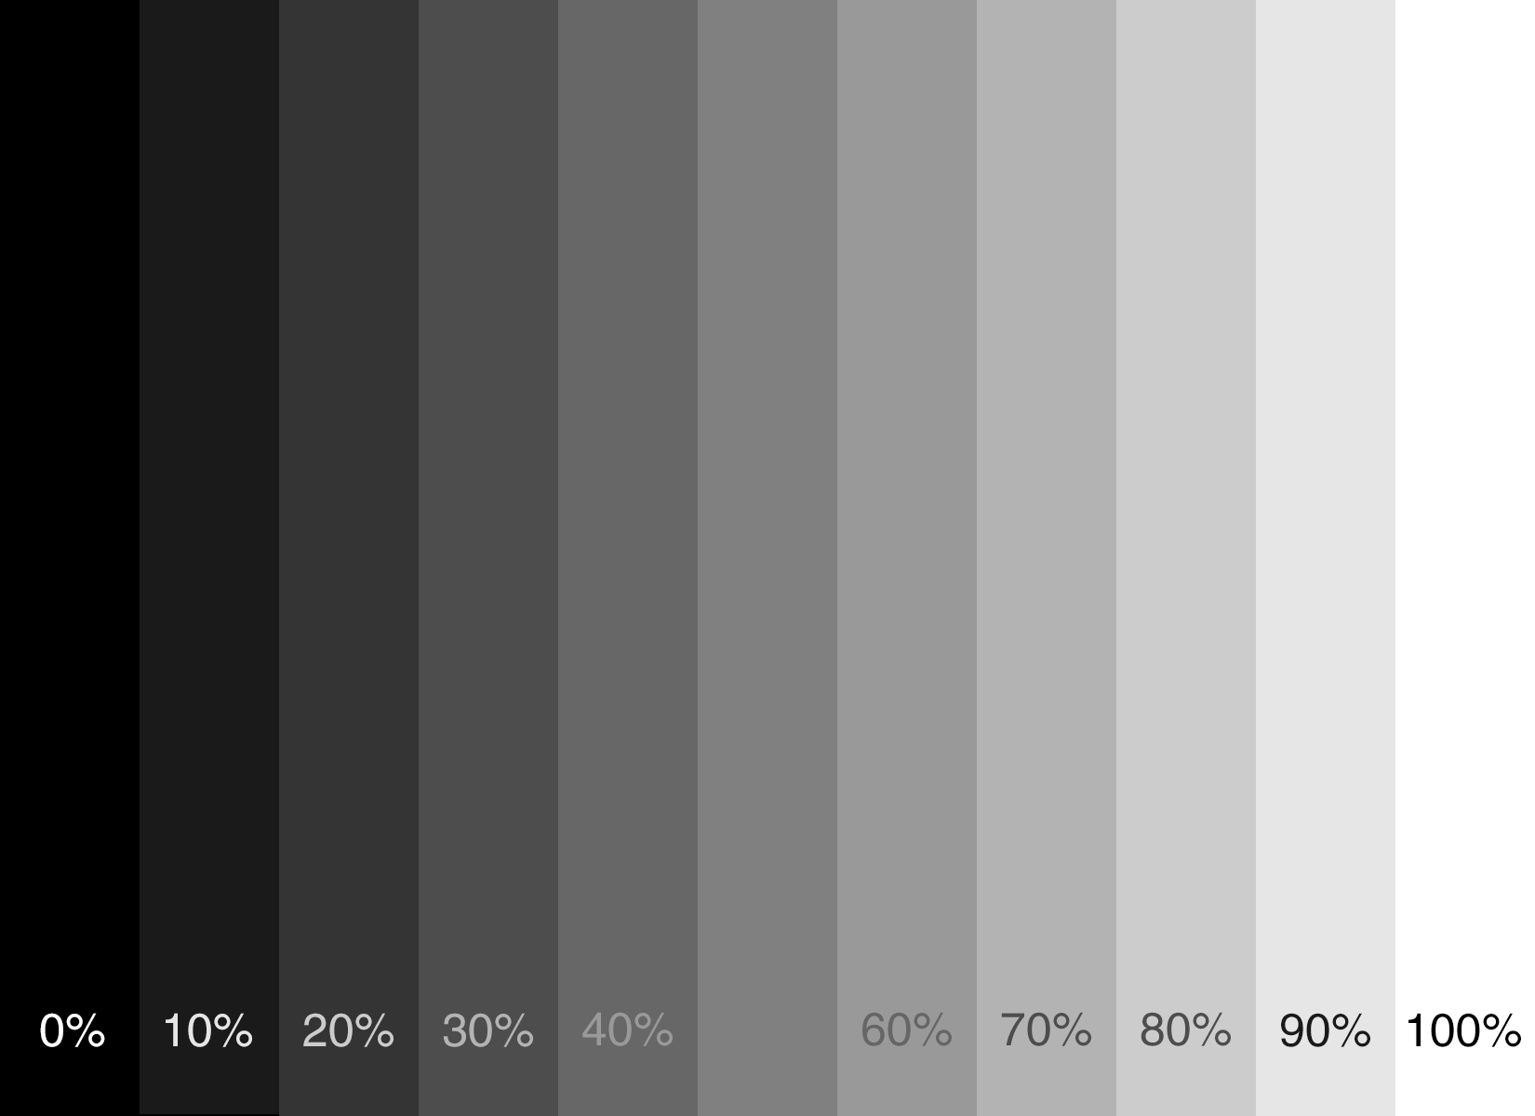
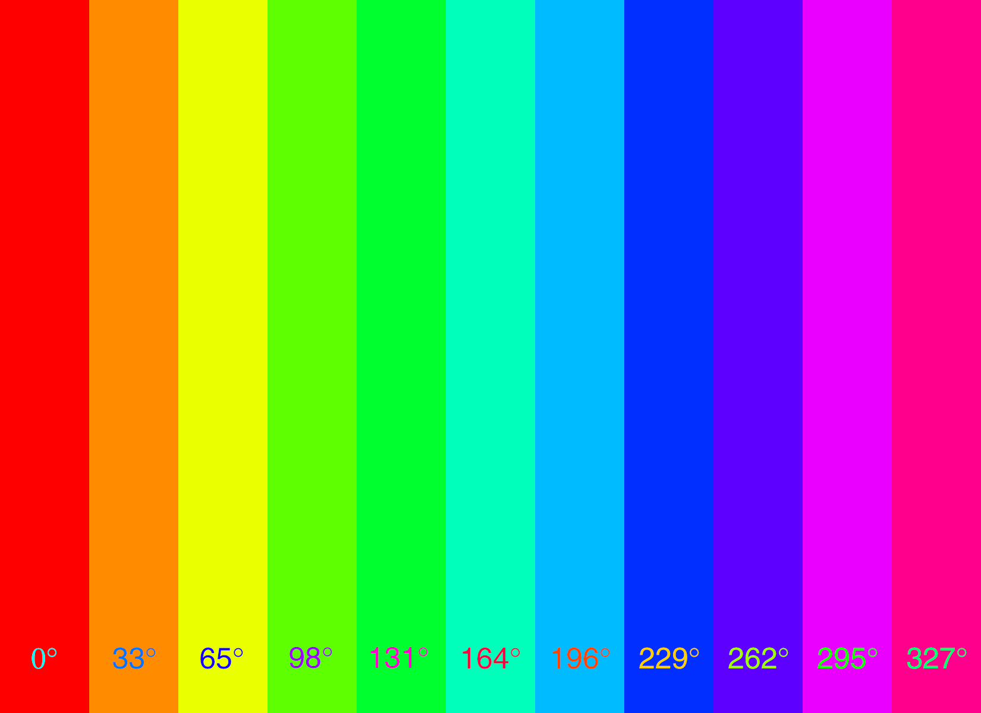
Center-Surround Brightness Perception
False gradients across constant bands

Slide 31
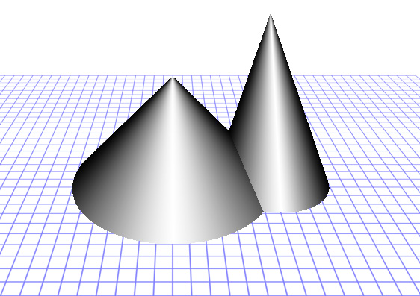
Center-Surround Brightness Perception
255
0
image
intensity profile
Linear intensity changes are not seen as such.

Slide 32
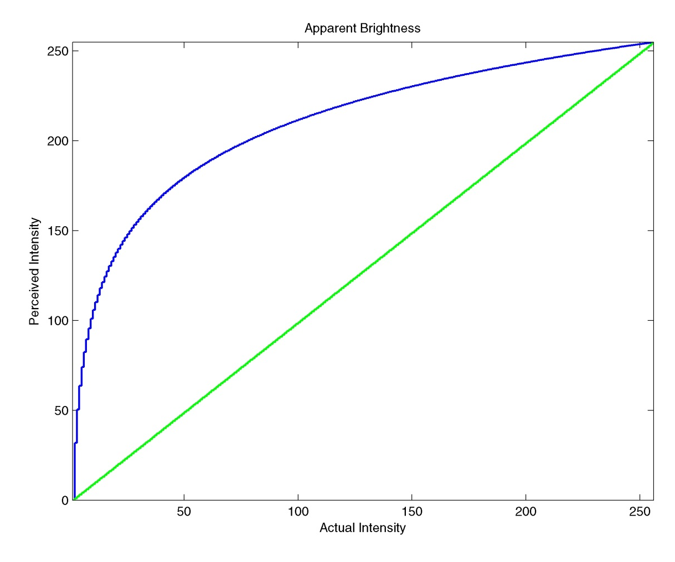
Brightness Perception: Weber-Fechner
The previous slide demonstrates the Weber-Fechner relation. The linear slope of the intensity change is perceived as logarithmic.
The green curve is the actual intensity; the blue curve is the perceived intensity.

Slide 33

Uniform Change in Intensity
uniform in fact ≠ uniform in perception

Slide 34
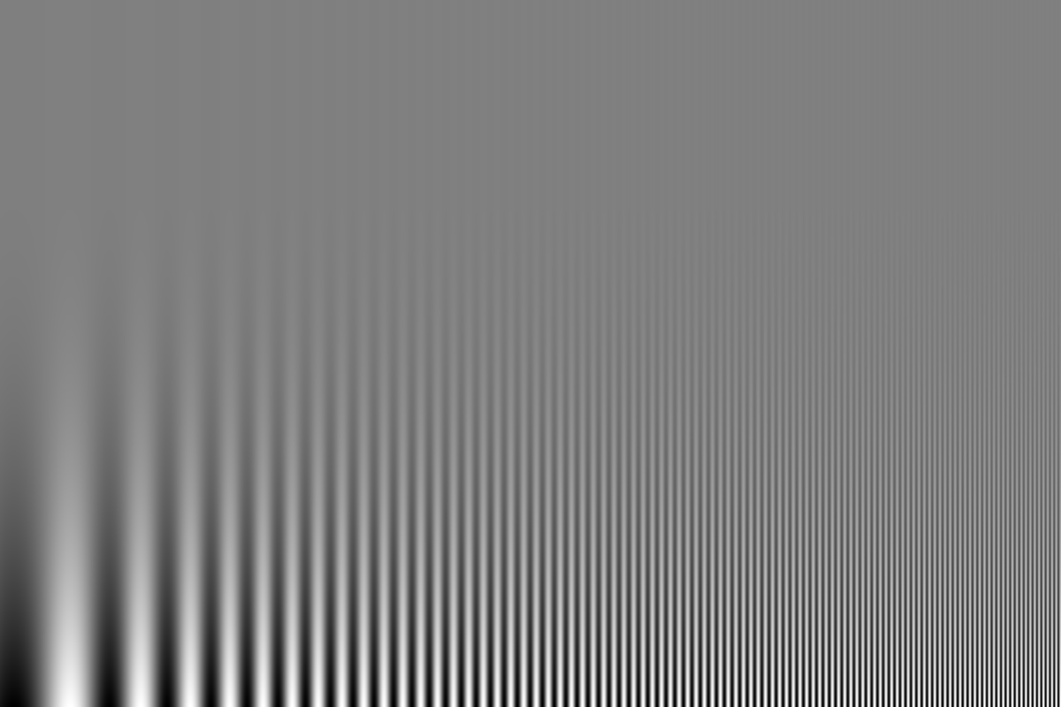
Uniform Change in Frequency and Contrast
uniform in fact ≠ uniform in perception
decreasing contrast
increasing frequency

Slide 35
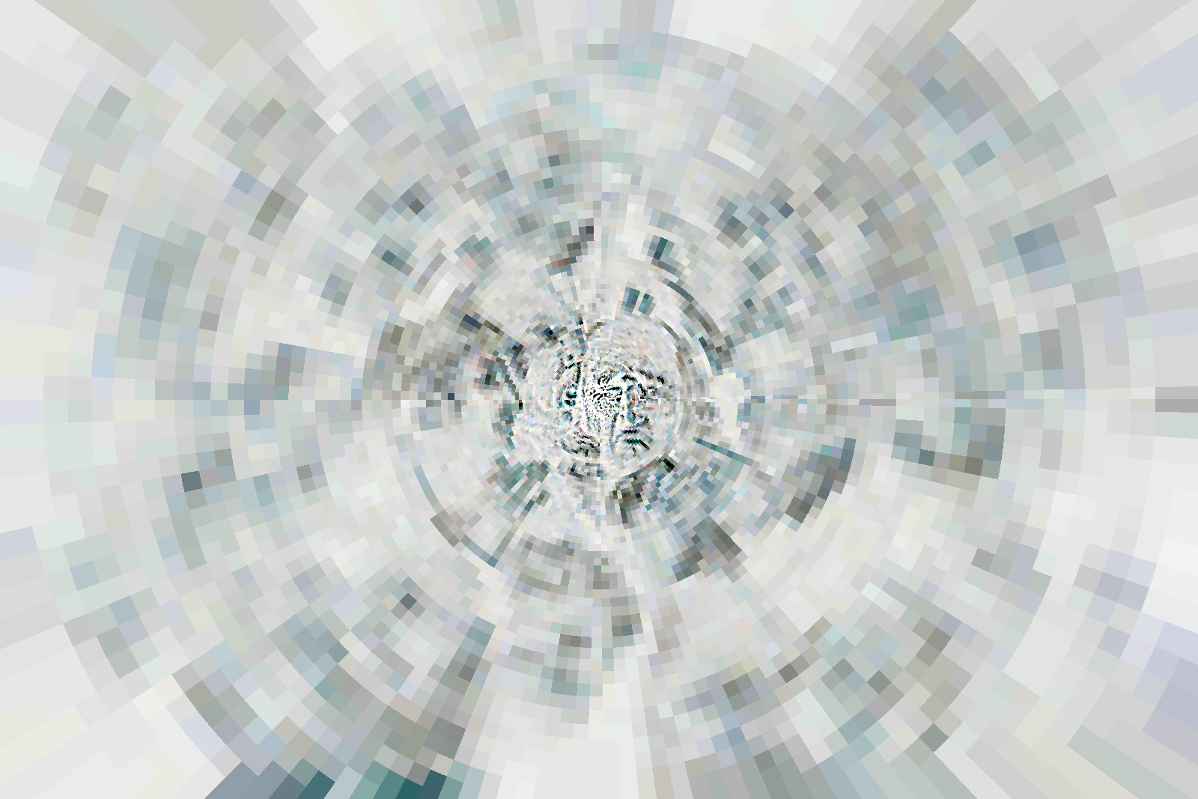
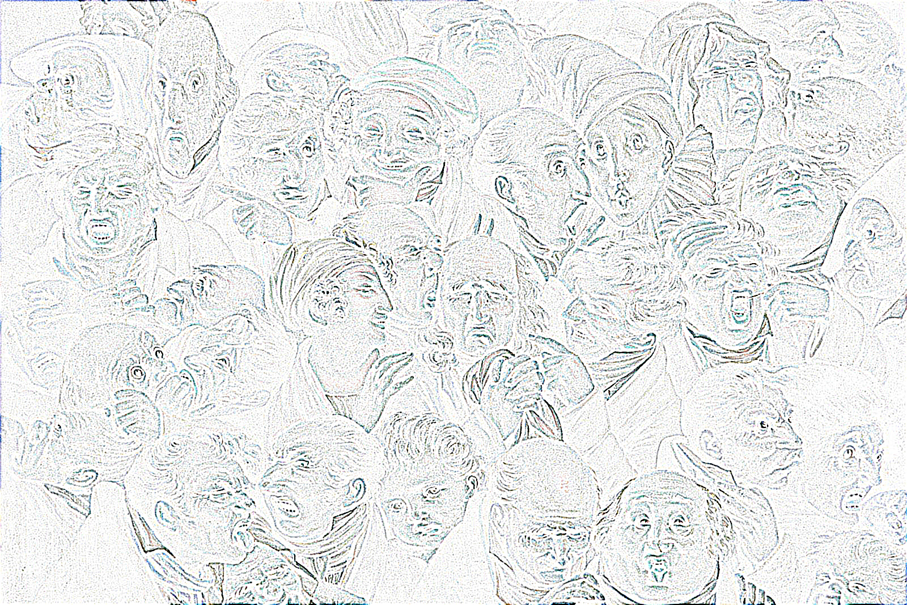
Center Surround Retinal Edge Detection
Louis Boilly (1761-1845) Thirty-Six Faces of Expression. Photo negative of LoG output.

Slide 36
Space Variant Retinal Edge Detection
Louis Boilly (1761-1845) Thirty-Six Faces of Expression. Photo negative of LoG output.

Slide 37
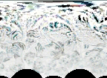

The Retinal Transform Minimizes Data Bandwidth
Louis Boilly (1761-1845) Thirty-Six Faces of Expression. Photo negative of LoG output.
This is the reduction in size from the full image to a compact multiresolution representation including the fovea (the disk) and the periphery.

Slide 38
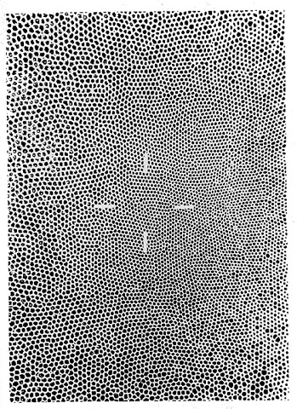
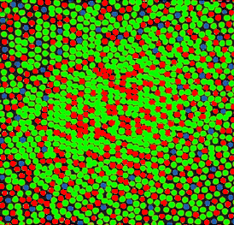
Retinal Mosaic
Human retina: #(R+G) receptors = 10 X #B receptors
Cepko, Connie, “Giving in to the blues”,
Nature Genetics, 24, 99 - 100 (2000)
cepko@genetics.med.harvard.edu

Slide 39
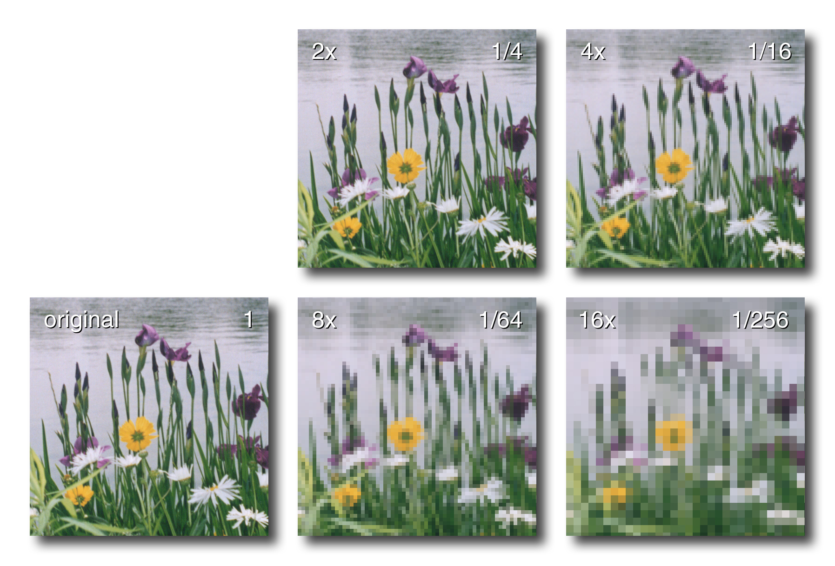
Pixelization of Color Images: All Bands Equal
L – downsample factor
R – information content
Photo: R. A. Peters II, 1998, The Lake, Central Park, NYC.

Slide 40

16× Pixelization of Color Images: R, G, & B Bands
L – downsample factor
R – information content
Photo: R. A. Peters II, 1998, The Lake, Central Park, NYC.

Slide 41
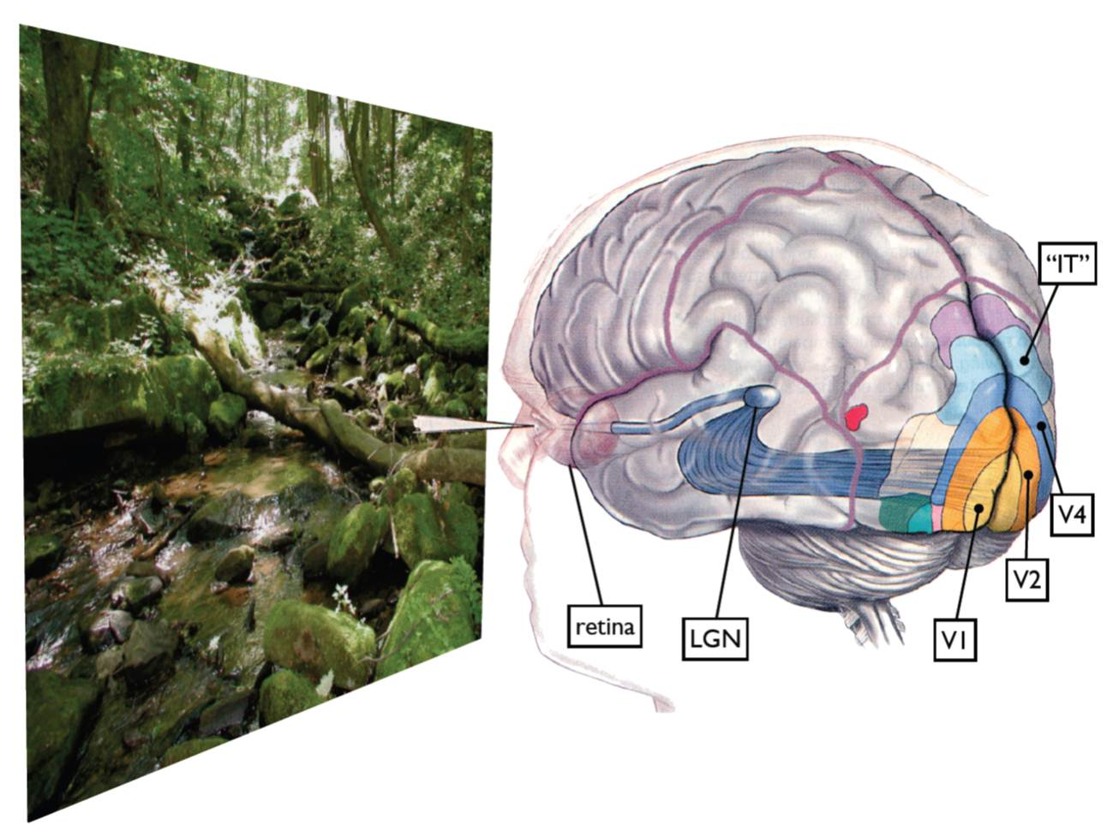
Visual Areas in the Brain
Retina: center-surround color feature detectors
LGN: (lateral geniculate nucleus) relay to V1; audio attention
V1: selective spatiotemporal filters
V2: feature aggregation
V3: visual attention
IT: (Inferior temporal gyrus) complex object features
Graphic from M. Lewicky

Slide 42
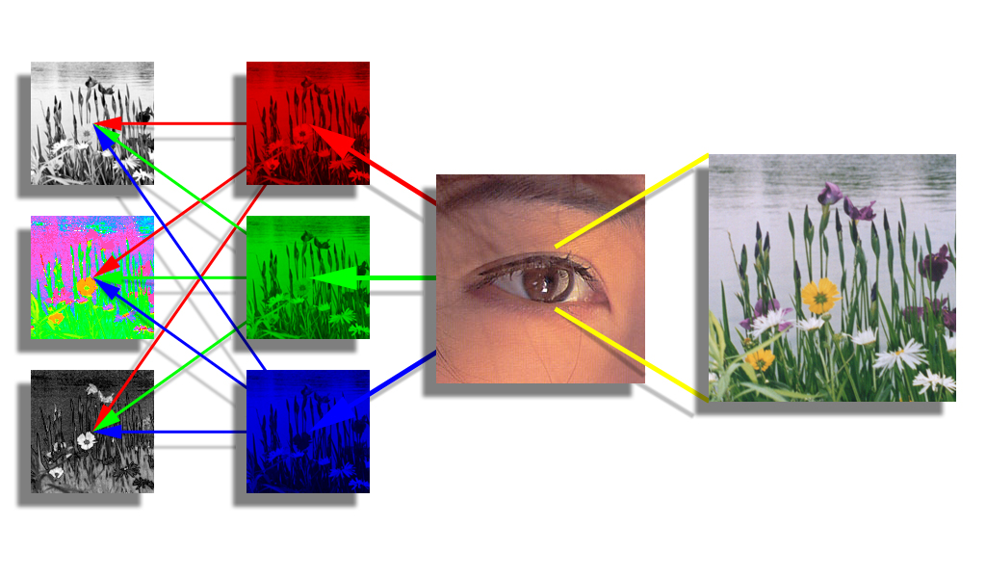
In the Brain: from RGB to LHS
luminance
The eye has 3 types of photoreceptors:
sensitive to red, green, or blue light.
hue
saturation
The brain transforms RGB into separate brightness and color channels (e.g., LHS).
brain
photo receptors

Slide 43

16× Pixelization of Color Images: Luminance Only
L – downsample factor
R – information content
Photo: R. A. Peters II, 1998, The Lake, Central Park, NYC.

Slide 44
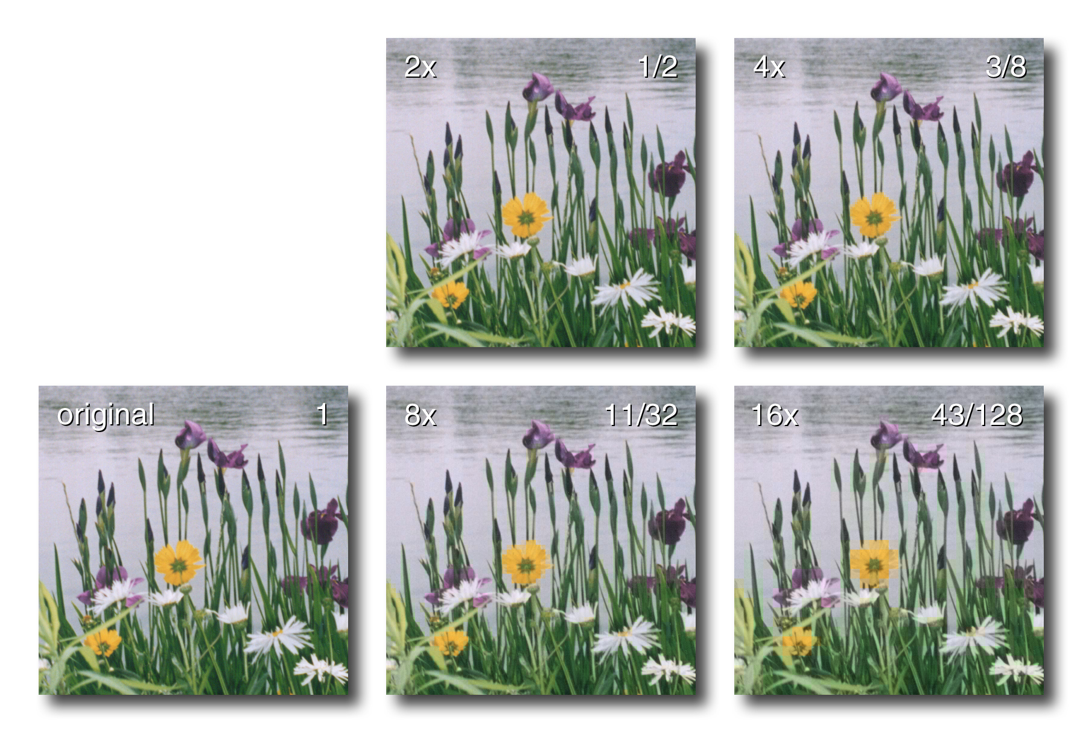
16× Pixelization of Color Images: Chrominance (H+S) Only
L – downsample factor
R – information content
Photo: R. A. Peters II, 1998, The Lake, Central Park, NYC.

Slide 45
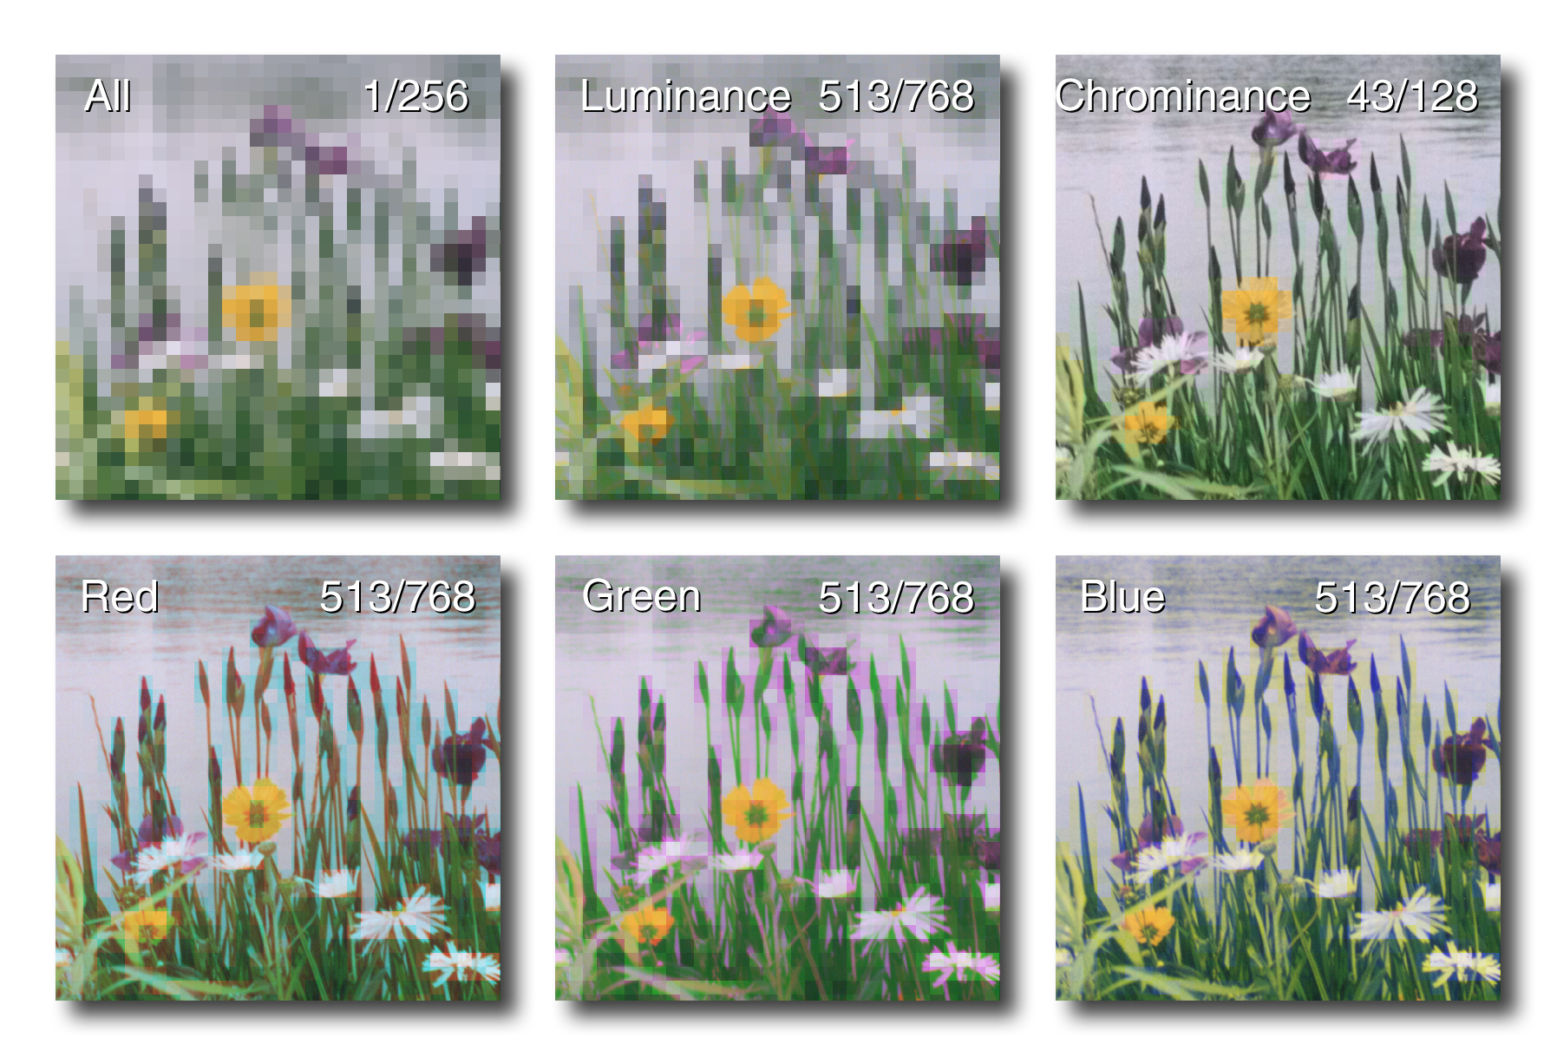
L – downsampled band
R – information content
16× Pixelization
Photo: R. A. Peters II, 1998, The Lake, Central Park, NYC.

Slide 46
L – downsampled band
R – information content
These 4 images all have the same amount of digital information…
16× Pixelization
Photo: R. A. Peters II, 1998, The Lake, Central Park, NYC.

Slide 47
L – downsampled band
R – information content
16× Pixelization
… but different visual information.
Photo: R. A. Peters II, 1998, The Lake, Central Park, NYC.

Slide 48
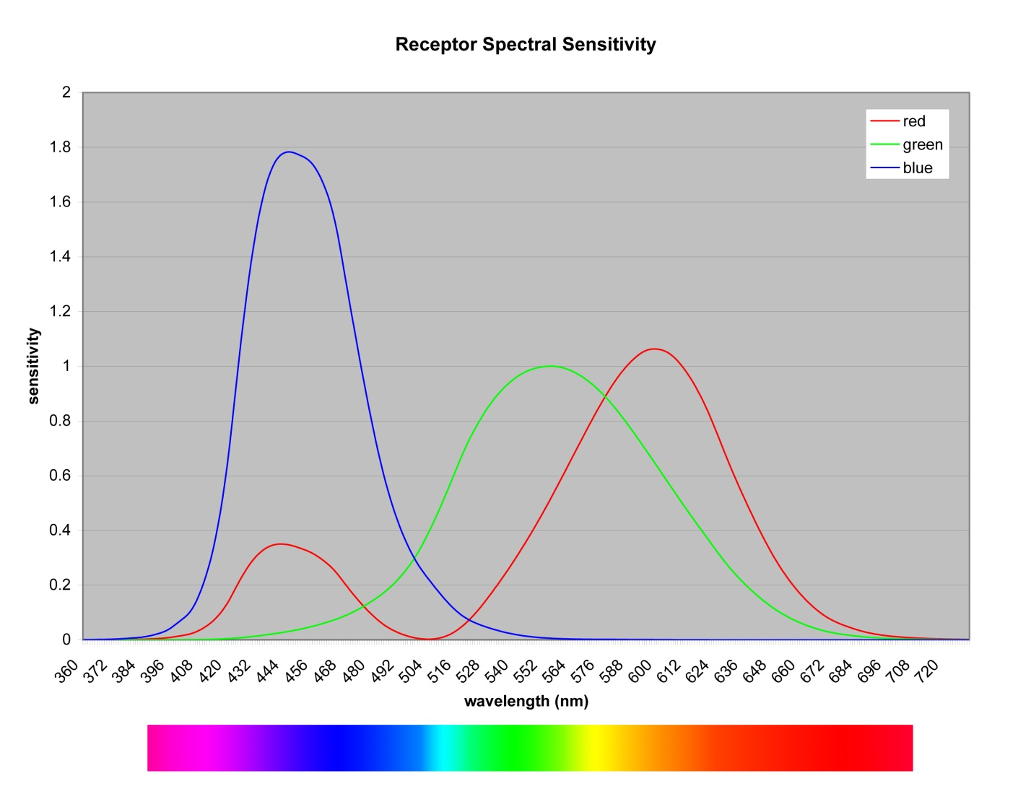
Color Sensing / Color Perception
These are approximations of the responses to the visible spectrum of the “red”, “green”, and “blue” receptors of a typical human eye.
Called L, M, & S receptors in the bio-vision literature
Notes:
The "green" and "red" cones are mostly packed into the fovea
centralis. By population, about 64% of the cones are red-sensitive,
about 32% green sensitive, and about 2% are blue sensitive. The
"blue" cones have the highest sensitivity and are mostly found
outside the fovea.

Slide 49
Color Sensing / Color Perception
Note that the “red” receptor exhibits the same response at 4 different wavelengths …
1
2
3
4
Notes:
The "green" and "red" cones are mostly packed into the fovea
centralis. By population, about 64% of the cones are red-sensitive,
about 32% green sensitive, and about 2% are blue sensitive. The
"blue" cones have the highest sensitivity and are mostly found
outside the fovea.

Slide 50
Color Sensing / Color Perception
… but the responses of the “green” and “blue” receptors differ …
1
2
3
4
b₁
r₁
g₁
Notes:
The "green" and "red" cones are mostly packed into the fovea
centralis. By population, about 64% of the cones are red-sensitive,
about 32% green sensitive, and about 2% are blue sensitive. The
"blue" cones have the highest sensitivity and are mostly found
outside the fovea.

Slide 51
Color Sensing / Color Perception
… at each of the 4 locations so that …
1
2
3
4
b₂
r₂
g₂
Notes:
The "green" and "red" cones are mostly packed into the fovea
centralis. By population, about 64% of the cones are red-sensitive,
about 32% green sensitive, and about 2% are blue sensitive. The
"blue" cones have the highest sensitivity and are mostly found
outside the fovea.

Slide 52
Color Sensing / Color Perception
… each of the 4 wavelengths is represented by a unique response from the set of 3 receptors.
1
2
3
4
g₃
r₃
b₃
Notes:
The "green" and "red" cones are mostly packed into the fovea
centralis. By population, about 64% of the cones are red-sensitive,
about 32% green sensitive, and about 2% are blue sensitive. The
"blue" cones have the highest sensitivity and are mostly found
outside the fovea.

Slide 53
Color Sensing / Color Perception
1
2
3
4
r₄
g₄
b₄
Notes:
The "green" and "red" cones are mostly packed into the fovea
centralis. By population, about 64% of the cones are red-sensitive,
about 32% green sensitive, and about 2% are blue sensitive. The
"blue" cones have the highest sensitivity and are mostly found
outside the fovea.

Slide 54

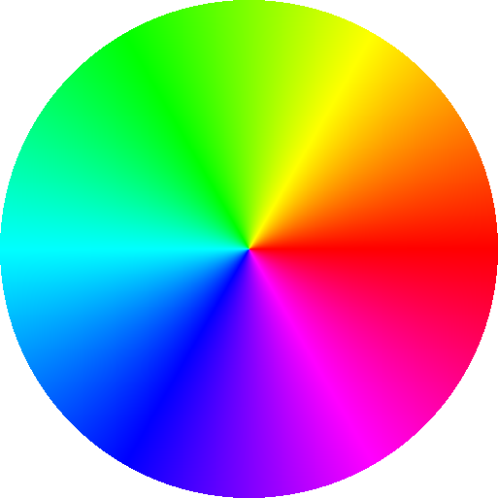
Color Sensing / Color Perception
These are approximations of the responses to the visible spectrum of the “red”, “green”, and “blue” receptors of a typical human eye.
The simultaneous red + blue response causes us to perceive a continuous range of hues on a circle. No hue is greater than or less than any other hue.
Notes:
The "green" and "red" cones are mostly packed into the fovea
centralis. By population, about 64% of the cones are red-sensitive,
about 32% green sensitive, and about 2% are blue sensitive. The
"blue" cones have the highest sensitivity and are mostly found
outside the fovea.

Slide 55

Complementary Colors
CYAN - RED
GREEN - MAGENTA
BLUE - YELLOW
CYAN - RED
GREEN - MAGENTA
BLUE - YELLOW
Colors opposite each other on the color disk are called “complementary”.

Slide 56

Complementary Colors
red
green
blue
response
color
0°
color
180°
response
red
green
blue
photoreceptor response is represented as proportional to brightness
To complementary colors, the response of the retina’s photoreceptors is opposite.
2016-09-20
1999-2011 by Richard Alan Peters II
56

Slide 57

Color Perception: The Afterimage Effect
Stare at the dot in the center of the image

Slide 58


Slide 59


Slide 60


Slide 61

Color Perception: The Afterimage Effect
The color “negatives” saturate the local receptors so that when the color is removed the agonist (opposite) color receptors remain saturated.

Slide 62

Color Perception: the Cornsweet Effect
Dale Purves, R. Beau Lotto, Surajit Nundy, “Why We See What We Do”, American Scientist, Volume 90, No. 3, May-June 2002

Slide 63
Color Perception: the Cornsweet Effect
The top is darker…
…than the bottom,
Right?
Dale Purves, R. Beau Lotto, Surajit Nundy, “Why We See What We Do”, American Scientist, Volume 90, No. 3, May-June 2002

Slide 64
Color Perception: the Cornsweet Effect
Wrong!
Dale Purves, R. Beau Lotto, Surajit Nundy, “Why We See What We Do”, American Scientist, Volume 90, No. 3, May-June 2002

Slide 65
Color Perception: the Cornsweet Effect
Dale Purves, R. Beau Lotto, Surajit Nundy, “Why We See What We Do”, American Scientist, Volume 90, No. 3, May-June 2002

Slide 66

Color Perception: the Munker Illusion
Blue and green spirals?

Slide 67

Color Perception: the Munker Illusion
No. Blue-green spirals.

Slide 68

Color Perception: the Munker Illusion
No. Blue-green spirals.

Slide 69

An Excellent and Amusing Website
Optical Illusions & Visual Phenomena

